Slide 1
Time-Varying
Fields

Slide 2
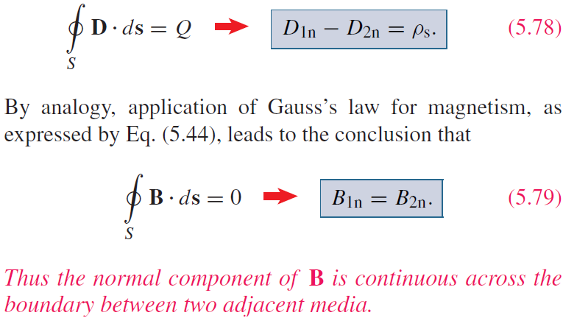
Boundary Conditions

Slide 3
Electric vs Magnetic Comparison
Field lines form closed loops
G.L.
Conservative →
← A.L.

Slide 5
Time-Varying Fields
Time-Varying Fields
Stationary charges electrostatic fields
Steady currents magnetostatic fields
Time-varying currents electromagnetic fields
Only in a non-time-varying case can electric and magnetic fields be considered as independent of each other. In a time-varying (dynamic) case the two fields are interdependent (coupled). A changing magnetic field induces an electric field, and vice versa.

Slide 6
Time-Varying Fields
The Continuity Equation
Electric charges may not be created or destroyed (the principle of conservation of charge).
Consider an arbitrary volume V bounded by surface S. A net charge Q exists within this region. If a net current I flows across the surface out of this region, the charge in the volume must decrease at a rate that equals the current:
Divergence theorem:
Partial derivative because may be a function of both time and space
This equation must hold regardless of the choice of V, therefore the integrands must be equal:
This equation must hold regardless of the choice of V, therefore the integrands must be equal:
the equation of
continuity
Kirchhoff’s current law
follows from this
For steady currents
that is, steady electric currents are divergenceless or solenoidal.

Slide 7
Time-Varying Fields
Displacement Current
For magnetostatic field, we have
Taking the divergence of this equation we find that
However, the continuity equation (accounting for time variation) requires that
Thus we must modify the magnetostatic curl equation to agree with the continuity equation. Let us add a term to the former so that it becomes
where is the conduction current density, and is to be determined and defined.

Slide 8
Time-Varying Fields
Displacement Current (continued)
Taking the divergence we have
In order for this equation to agree with the continuity equation,
Gauss’ law
displacement current density
Stokes’ theorem

Slide 9
Time-Varying Fields
Displacement Current (continued)
A typical example of displacement current is the current through a capacitor when an alternating voltage source is applied to its plates. The following example illustrates the need for the displacement current.
Using an unmodified form of Ampere’s law:
S₁
(no conduction current flows through ( =0))
S₂
To resolve the conflict we need to include in Ampere’s law.

Slide 10
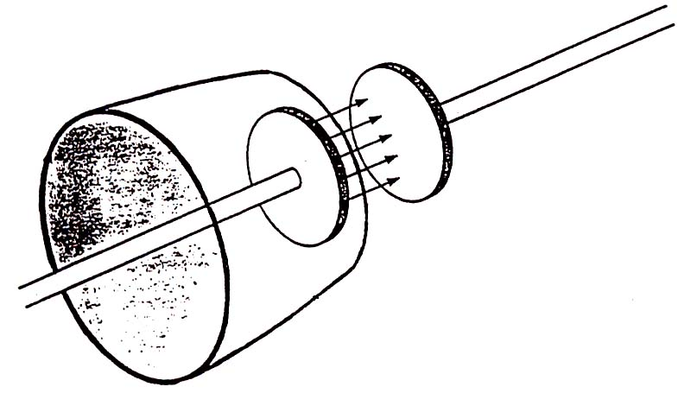
Time-Varying Fields
Displacement Current (continued)
Charge -Q
Charge +Q
The total current density is .In the first equation so it remains valid. In the second equation so that
Q
I
Surface S1
Path L
Charge -Q
Charge +Q
So we obtain the same current for either surface though it is conduction current in and displacement current in .
I
Surface S2
Path L

Slide 11
Electric vs Magnetic Comparison
Field lines form closed loops
G.L.
Conservative →
← A.L.

Slide 12
Time-Varying Fields
Faraday’s Law
Faraday discovered experimentally that a current was induced in a conducting loop when the magnetic flux linking the loop changed. In differential (or point) form this experimental fact is described by the following equation
Taking the surface integral of both sides over an open surface and applying Stokes’ theorem, we obtain
Integral form
where is the magnetic flux through the surface S. Examples: transformer, etc.
Time-varying electric field is not conservative (voltage between two points may be not unique).
Induced emf v(t) depends on B, S, cosθ and their rate of change. Also on the number of turns N:

Slide 13
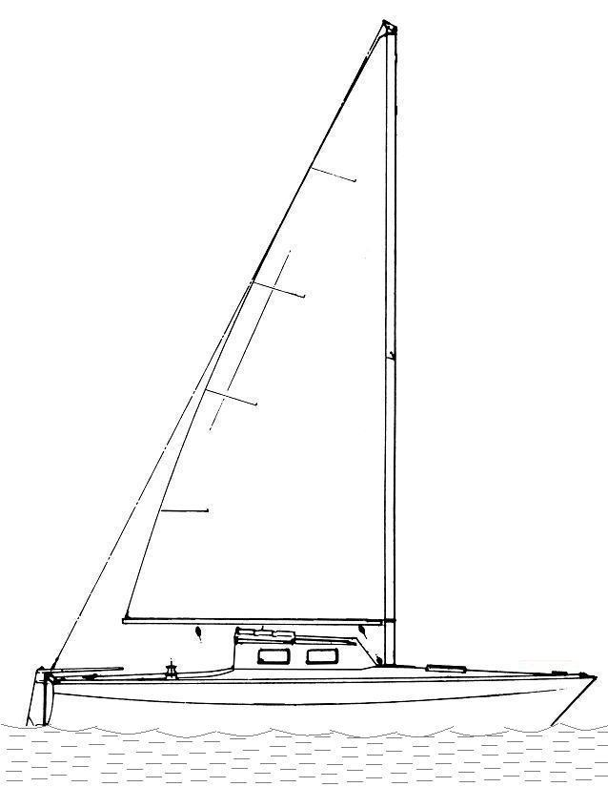
Lightning Parameters vs. Damage Mechanisms
dI/dt = 100 kA/µs
Maximum rate-of-change of current (dI/dt)
Lightning induced effects are often related to dI/dt
According to Faraday’s Law:
r = 2 m
Area A
(for A = 1 m²)
H = I/2πr (Ampere’s law)
dH/dt = (dI/dt)/2πr
dB/dt = μ₀(dH/dt)
= μ₀(dI/dt)/2πr
For A = (10 × 10) cm² , V = 100 V
13
Notes:
13

Slide 14
Time-Varying Fields
Faraday’s Law (continued)
Time-varying electric field is not conservative
Suppose that there is only one unique voltage . Then
B
However,
Path L1
Path L2
A
The effect of electromagnetic induction. When time-varying magnetic fields are present, the value of the line integral of from A to B may depend on the path one chooses (the larger the area, the larger the difference).
Thus can be unambiguously defined only if (in practice, if than the dimensions of system in question)

Slide 15
Time-Varying Fields
Faraday’s Law (continued)
According to Faraday’s law, a time-varying magnetic flux through a loop of wire results in a voltage across the loop terminals:
The negative sign shows that the induced voltage acts in such a way as to oppose the change of flux producing it (Lenz’s law).
Induced magnetic field (when circuit is closed)
Increasing time-varying
magnetic field
Direction of the integration path
I
3
R
-
2
+
1
4
The terminals are far away from the time-varying magnetic field
If N-turn coil instead of single loop
Consider now terminals 3 and 4, and 1 and 2
A time-varying magnetic flux through a loop wire results in the appearance of a voltage across its terminals.
2
3
No contribution from 2-3 and 4-1 because the wire is a perfect conductor
1
4
Integration path

Slide 16
Time-Varying Fields
Faraday’s Law continued
Example: An N-turn coil having an area A rotates in a uniform magnetic field The speed of rotation is n revolutions per second. Find the voltage at the coil terminals.
B = const
A = const
rad
Rotation
Shaft

Slide 17
Time-Varying Fields
Inductance
A circuit carrying current I produces a magnetic field which causes a flux to pass through each turn of the circuit. If the medium
surrounding the circuit is linear, the flux is proportional to the current I producing it .
For a time-varying current, according to Faraday’s law, we have
+
-
(voltage induced across coil)
I
I
, H (henry)
Magnetic field B produced by a circuit.
Self-inductance L is defined as the ratio of the magnetic flux linkage to the current I.

Slide 18
Time-Varying Fields
Inductance (continued)
In an inductor such as a coaxial or a parallel-wire transmission line, the inductance produced by the flux internal to the conductor is called the internal inductance L_{in} while that produced by the flux external to it is called external inductance
( )
Let us find of a very long rectangular loop of wire for which , and . This geometry represents a parallel-conductor transmission line. Transmission lines are usually characterized by per unit length parameters.
Wire radius = a
1
I
w
S
h
Finding the inductance per unit length of a parallel-conductor transmission line.

Slide 19
Inductance (cont’d) The magnetic field produced by each of the long sides of the loop is given approximately by
(Ampere’s Law)
Parallel–conductor transmission line
, H/m (per unit length)
The internal inductance for nonferromagnetic materials is usually negligible compared to .

Slide 20
Inductance (cont’d) Let us find the inductance per unit length of a coaxial transmission line. We assume that the currents flow on the surface of the conductors, which have no resistance.
h
b
I
a
z
Finding the inductance per unit length of a coaxial transmission line.

Slide 21
Time-Varying Fields
Inductance (continued)
Faraday’s
Law
Resistance
Since R=0, has only radial component and therefore the segments 3 and 4 contribute nothing to the line integral.
Voltage drop
between z
and z+h
v(z)-v(z+h)
Lossless coaxial
transmission
line
(from previous work, for lossless TLs)
It follows that v(z)-v(z+h) = Lh(dI/dt)
H/m

Slide 22
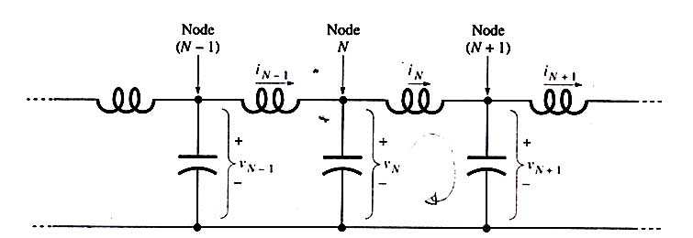
Transmission Lines
(slide 5)
i_{NS}
N’
(N+1)’
Definitions of currents and voltages for the lumped-circuit lossless transmission-line model.
By applying Kirchhoff’s voltage law to N - (N + 1) - (N + 1)’ - N’ loop, we obtain
If node N is at the position z, node (N +1) is at position z + h, and

Slide 23
Time-Varying Fields
Boundary Condition on Tangential Electric Field
Using Faraday’s law, , we can obtain boundary condition on the
tangential component of at a dielectric boundary.
Medium 1
Medium 2
(unless )
L
3
E_{t1}l – E_{t2}l = 0
L
1
continuous across the boundary, which also applies to a conductor/dielectric boundary
(For the normal component: )
at a dielectric boundary

Slide 24
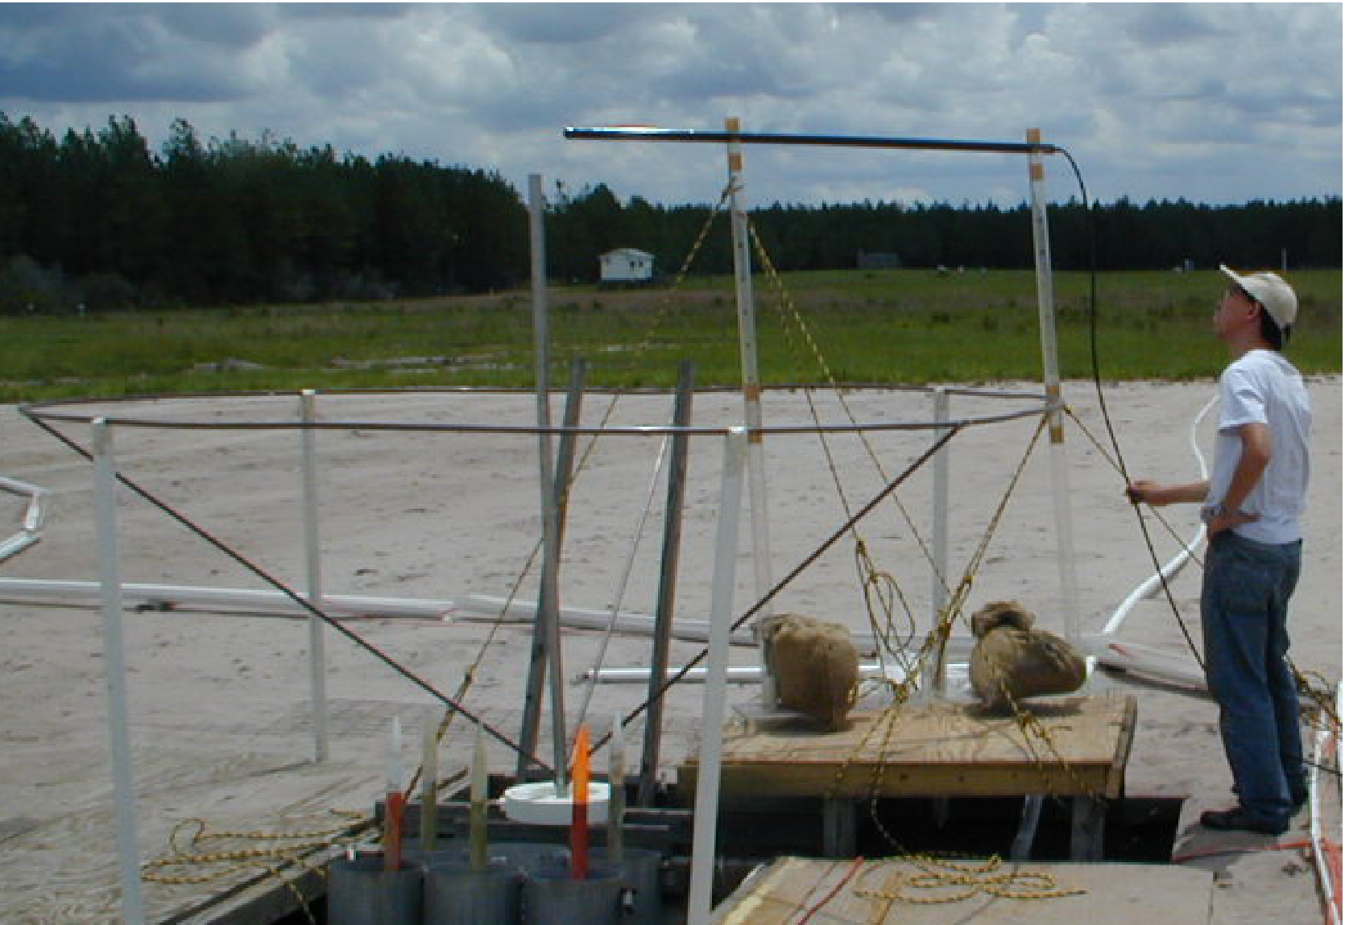
Electric Fields in the Immediate Vicinity of the Lightning Channel Core
Vertical and horizontal (radial) components of electric field in the immediate vicinity (within 0.1 to 1.6 m) of the triggered-lightning channel were measured with Pockels sensors at Camp Blanding, Florida, in 2000 (Miki et al., 2002)
24

Slide 25
Estimation of Input Energy in Rocket-Triggered Lightning Strokes
Vertical electric field, E(t), measurements in the immediate vicinity (within 0.1 to 1.6 m) of the lightning channel (Miki et al. 2002) and current, I(t), measurements at the channel base were used to estimate power per unit length, P(t) = E(t) I(t), as a function of time (up to 50 μs). Integrating this power over time, we obtained lightning input energy per unit length. The implication here is that the vertical electric field within 0.1 to 1.6 m of the lightning channel is not much different from the longitudinal electric field inside the channel.
Lightning channel
I(t)
E(t)
r
Lightning input energy is needed in a number of areas including the determination of NO produced by lightning and the testing of proposed thunder generation mechanisms. There is presently no consensus on the energy associated with the lightning return stroke (10³ to 10⁵ J/m).
25

Slide 26
Time-Varying Fields
General Forms of Maxwell’s Equations
Differential Integral Remarks
1
Gauss’ Law
Nonexistence
of isolated magnetic charge
2
3
Faraday’s Law
4
Ampere’s
Law
In 1 and 2, S is a closed surface enclosing the volume V
In 2 and 3, L is a closed path that bounds the surface S

Slide 27
Time-Varying Fields
Electric fields can originate on positive charges and can end on negative charges. But since nature has neglected to supply us with magnetic charges, magnetic fields cannot begin or end; they can only form closed loops.

Slide 28
Time-Varying Fields
Sinusoidal Fields
In electromagnetics, information is usually transmitted by imposing amplitude, frequency, or phase modulation on a sinusoidal carrier. Sinusoidal (or time-harmonic) analysis can be extended to most waveforms by Fourier and Laplace transform techniques.
Sinusoids are easily expressed in phasors, which are more convenient to work with. Let us consider the “curl H” equation.
Its phasor representation is
is a vector function of position, but it is independent of time. The three scalar components of are complex numbers; that is, if
then

Slide 29
Time-Varying Fields
Sinusoidal Fields (continued)
Time-Harmonic Maxwell’s Equations Assuming Time Factor .
Point Form Integral Form

Slide 30
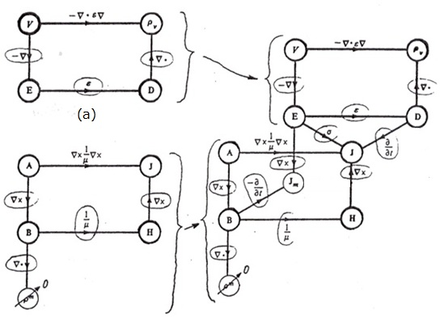
Maxwell’s Equations (continued)
Time-Varying Fields
Electrostatics
Electrodynamics
(a)
Magnetostatics
Ampere’s Law
Faraday’s Law
(b)
(c)
“Free magnetic charge density” ( )
Electromagnetic flow diagram showing the relationship between the potentials and vector fields: (a) electrostatic system, (b) magnetostatic system, (c) electromagnetic system. [Adapted with permission from IEE Publishing Department]

Slide 31
Time-Varying Fields
Sinusoidal Fields (continued)
Time-Harmonic Maxwell’s Equations Assuming Time Factor .
Point Form Integral Form

Slide 32
Time-Varying Fields
The Electromagnetic Skin Effect
When time-varying fields are present in a material that has high conductivity, the fields and currents tend to be confined to a region near the surface of the material. This is known as the “skin effect”. Skin effect increases the effective resistance of conductors at high frequencies.
Let us consider the vector wave equation (Helmholtz’s equation) for the electric field:
If the material in question is a very good conductor, so that , we can write
Since
we also have:
Consider current flowing in the +x direction through a conductive material filling the half-space z<0. The current density is independent of y and x, so that we have
0
z
Skin depth
Current density at surface J₀
(Air) Z>0
x
y
(Metal) Z<0
Magnitude of current density decreases exponentially with depth

Slide 33
Time-Varying Fields
The Skin Effect (continued)
As , the first term increases and would give rise to infinitely large currents. Since this is physically unreasonable, the constant A must vanish. From the condition when z=0 we have
Current density magnitude decreases exponentially with depth. Its phase changes as well.
and
At
10mm
1mm
0.1mm
At
Skin depth versus frequency for copper

Slide 34
Time-Varying Fields
Time-Varying Fields
Surface Impedance
If , the total current per unit width is
45° out of phase with Jo
Since we can write
Voltage per unit length
Surface impedance
or
Direction of current flow
“ohms per square”
w
l
If l=w (a square surface)
Illustrating the concept of “ohms per square”

Slide 35
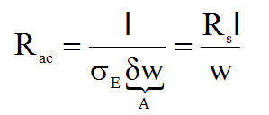
Time-Varying Fields
Surface Impedance (continued)
R_{S} is equivalent to the dc resistance per unit length of the conductor having cross-sectional area
Copper
For a wire of radius α,

Slide 36
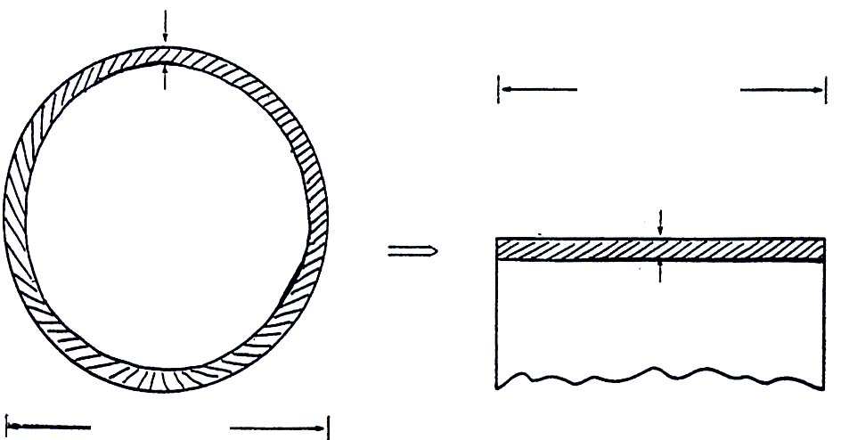
Time-Varying Fields
Time-Varying Fields
Surface Impedance (continued)
Wire (copper) bond
Z=?
Plated metal connections
Substrate
(a)
Thickness of current layer = 0.6 μm = δ
w
x 100 μm
2 r
δ = 0.6 μm
(Internal inductance)
100 μm
(b)
(c)
Finding the resistance and internal inductance of a wire bond. The bond, a length of wire connecting two pads on an IC, is shown in (a). (b) is a cross-sectional view showing skin depth. In (c) we imagine the conducting layer unfolded into a plane.

Slide 37
Time-Varying Fields
The Skin Effect (continued)
Skin Depth and Surface Resistance for Metals
Metal |  | A | B
Silver
Copper
Gold
Aluminum
Iron

