Slide 1
Review of Vector Analysis

Slide 2
Review of Vector Analysis
Review of Vector Analysis
Vector analysis is a mathematical tool with which
electromagnetic (EM) concepts are most conveniently expressed and best comprehended.
A quantity is called a scalar if it has only magnitude (e.g., mass, temperature, electric potential, population).
A quantity is called a vector if it has both magnitude and direction (e.g., velocity, force, electric field).
The magnitude of a vector is a scalar written as:
A
or

Slide 3
Review of Vector Analysis
A unit vector along is defined as a vector whose magnitude is unity (that is, 1) and its direction is along
Thus,
A
which completely specifies in terms of and its direction

Slide 4
Review of Vector Analysis
A vector in Cartesian (or rectangular) coordinates may be represented as:
or
where A_{X}, A_{y}, and A_{Z} are called the components of
in the x, y, and z directions, respectively; , , and are unit vectors in the x, y and z directions, respectively.

Slide 5
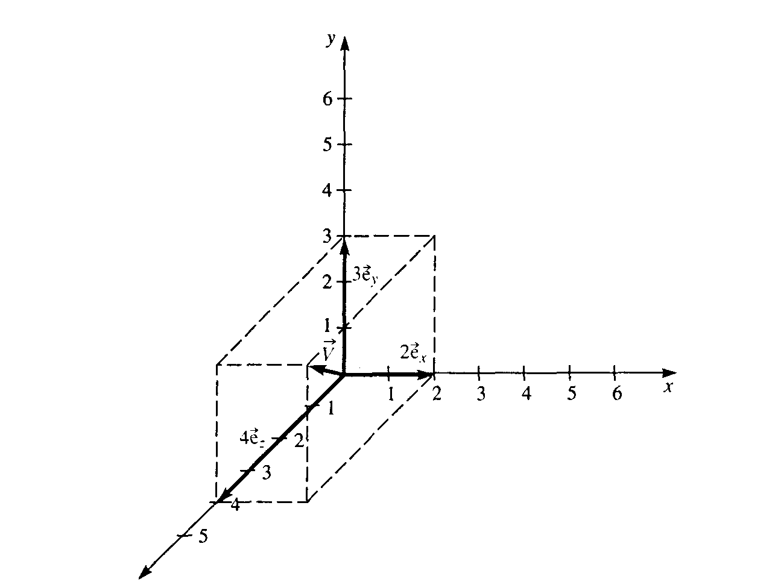
Review of Vector Analysis
Suppose a certain
vector is given by
z
P
The magnitude or absolute value of the vector is:
(from the Pythagorean theorem)

Slide 6
The Radius Vector
Review of Vector Analysis
A point P in Cartesian coordinates may be represented by
specifying (x, y, z). The radius vector (or position vector) of point P is defined as the directed distance from the origin O to P; that is,
The unit vector in the direction of is

Slide 7
Vector Algebra
Review of Vector Analysis
Two vectors and can be added together to give another vector ; that is,
Vectors are added by adding their individual components. Thus, if
and

Slide 8
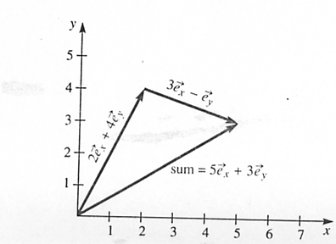
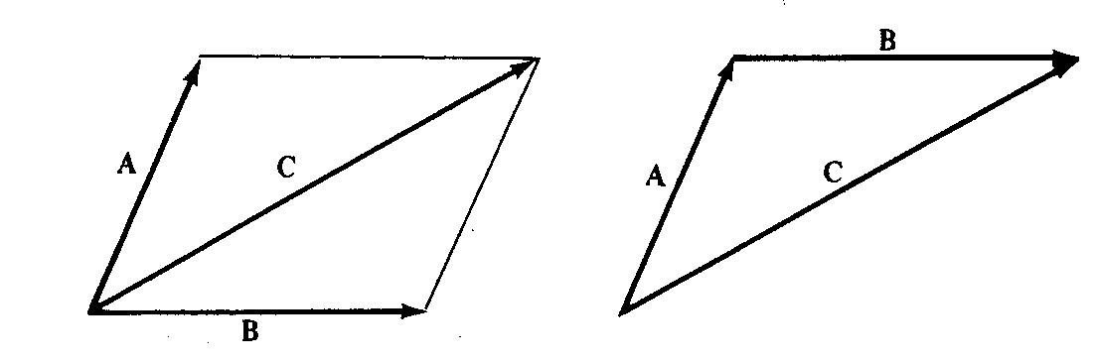
Review of Vector Analysis
Parallelogram Head-to-tail
rule rule
Vector subtraction is similarly carried out as

Slide 9
Review of Vector Analysis
The three basic laws of algebra obeyed by any given vector
A, B, and C, are summarized as follows:
Law Addition Multiplication
Commutative
Associative
Distributive
where k and l are scalars

Slide 10
Time Table, updated on 09/21/20
Course Section | Number of Lectures | HA Given | HW Due | Chapter(s) in Text (Ulaby)
Introduction | 1 | - | - | 1
1. Transmission Lines | 7 | 09/21 | 09/23 | 2
2. Review of Vector Analysis | 5 | 10/05 | 10/07 | 3
3. Electrostatics | 7 | 10/19 | 10/21 | 4
4. Magnetostatics | 5 | 11/02 | 11/04 | 5
5. Time-Varying Fields | 8 | 11/20 | 11/23 | 6, 5.7, 7.5
6. Electromagnetic Waves | 6 | 12/07 | 12/09 | 7, 8
Review | 1 | - | - | 1-8
Final Exam (format to be announced later) Group 18C | - | - | 12/18 (12:30-2:30 p.m.) | 1-8

Slide 11
READING ASSIGNMENT FOR SECTION 2
(Review of Vector Analysis)
Textbook (Ulaby and Ravaioli): In Ch. 3, Sections 3.1 – 3.3, and 3.6 (introductory part and subsection 3.6.1), Chapter 3 Summary (pp. 169-170)
Exercises: 3-1 to 3-8, and 3-14
Examples: 3-1 to 3-5, 3.7, and 3.8
Course Packet (Lecture Slides): Review of Vector Analysis
HA2 (take-home Test 2) will be given on Oct. 5 (M) between 1 and 2 p.m.; HW2 is to be turned in via Canvas not later than Oct. 7 (W), 11:45 a.m.

Slide 12
2. REVIEW OF VECTOR ANALYSIS - 5 lectures
- Vector addition and subtraction
- Dot and cross products
- Line and surface integrals
- Introduction to differential operators
- Cartesian, cylindrical, and spherical
coordinates

Slide 13
Review of Vector Analysis
When two vectors and are multiplied, the result is
either a scalar or a vector depending on how they are
multiplied. There are two types of vector multiplication:
1. Scalar (or dot) product:
2. Vector (or cross) product:
The dot product of the two vectors and can be defined
geometrically as the product of the magnitude of and the
projection of onto (or vice versa):
where is the smaller angle between and

Slide 14
Review of Vector Analysis
If and , then
which is obtained by multiplying and component by
component
cos(0º) = 1
cos(90º) = 0
cos(0º) = 1

Slide 15
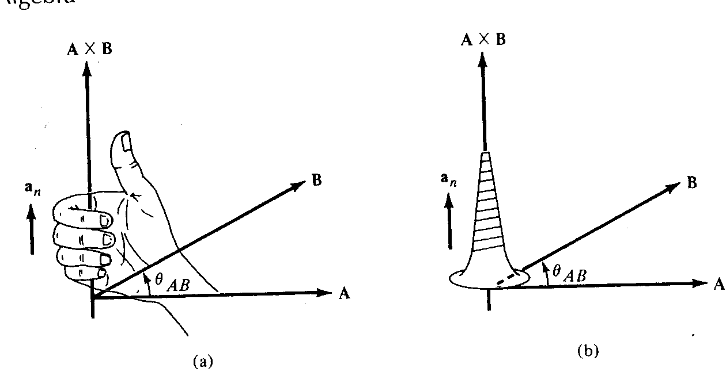
Review of Vector Analysis
The cross product of two vectors and is defined as
where is a unit vector normal to the plane containing
and . The direction of is determined using the right-
hand rule or the right-handed screw rule.
Directions of
and according to
(a) right-hand rule,
(b) right-handed
screw rule

Slide 16
Review of Vector Analysis
If and then

Slide 17
Review of Vector Analysis
Note that the cross product has the following basic
properties:
(i) It is not commutative:
It is anticommutative:
(ii) It is not associative:
(iii) It is distributive:
(iv)

Slide 18
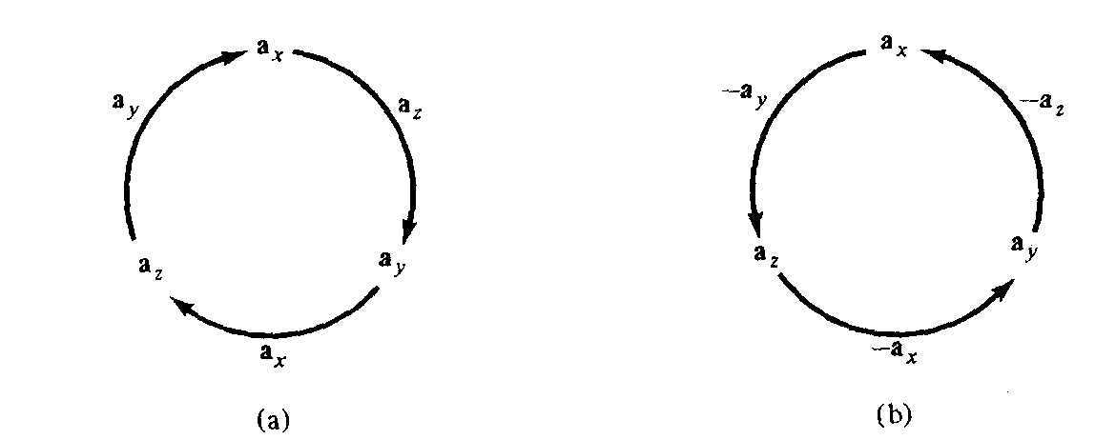
Review of Vector Analysis
Also note that
which are obtained in cyclic permutation and illustrated
below.
sin(90º) = 1
Cross product using cyclic permutation: (a) moving clockwise leads to positive results; (b) moving counterclockwise leads to negative results.

Slide 19
Review of Vector Analysis
Scalar and Vector Fields
A field can be defined as a function that specifies a particular quantity everywhere in a region (e.g., temperature distribution in a room), or as a spatial distribution of a quantity, which may or may not be a function of time.
Scalar quantity scalar function of position scalar field
Vector quantity vector function of position vector field

Slide 20
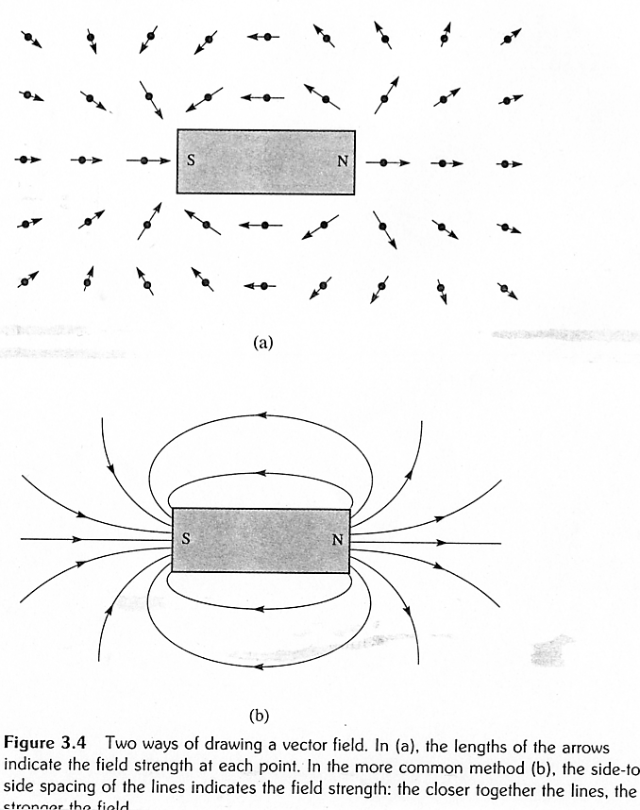
Review of Vector Analysis
The lengths of the arrows indicate the field strength
The side-to-side spacing of the lines indicates the field strength

Slide 21
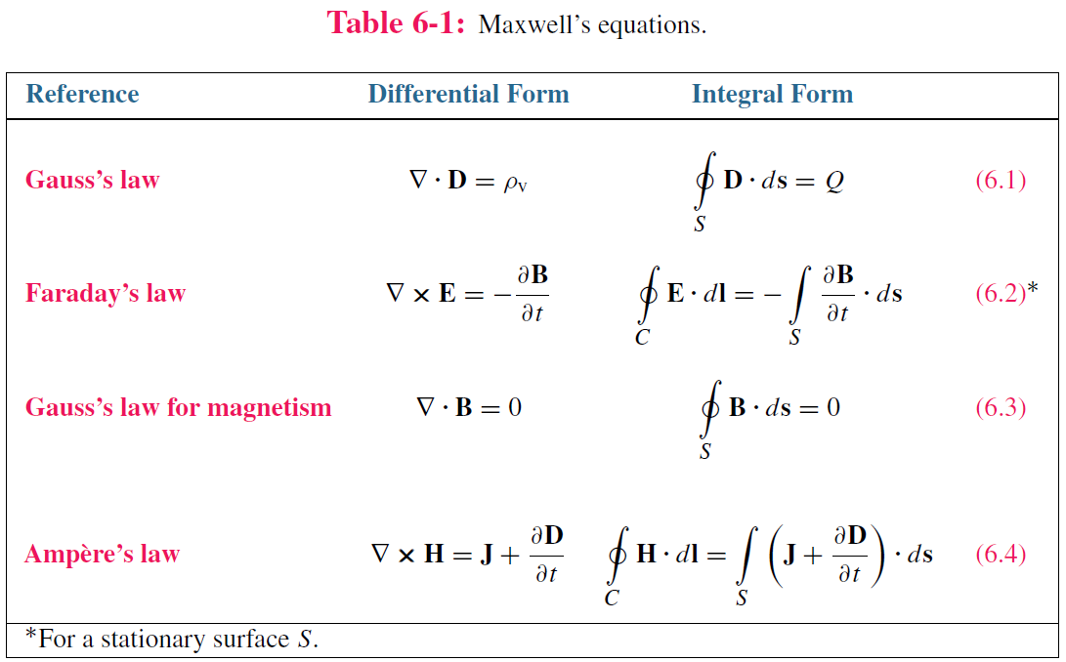
Maxwell’s Equations

Slide 22
Review of Vector Analysis
Line Integrals
A line integral of a vector field can be calculated whenever a path has been specified through the field.
The line integral of the field along the path P is defined as

Slide 23
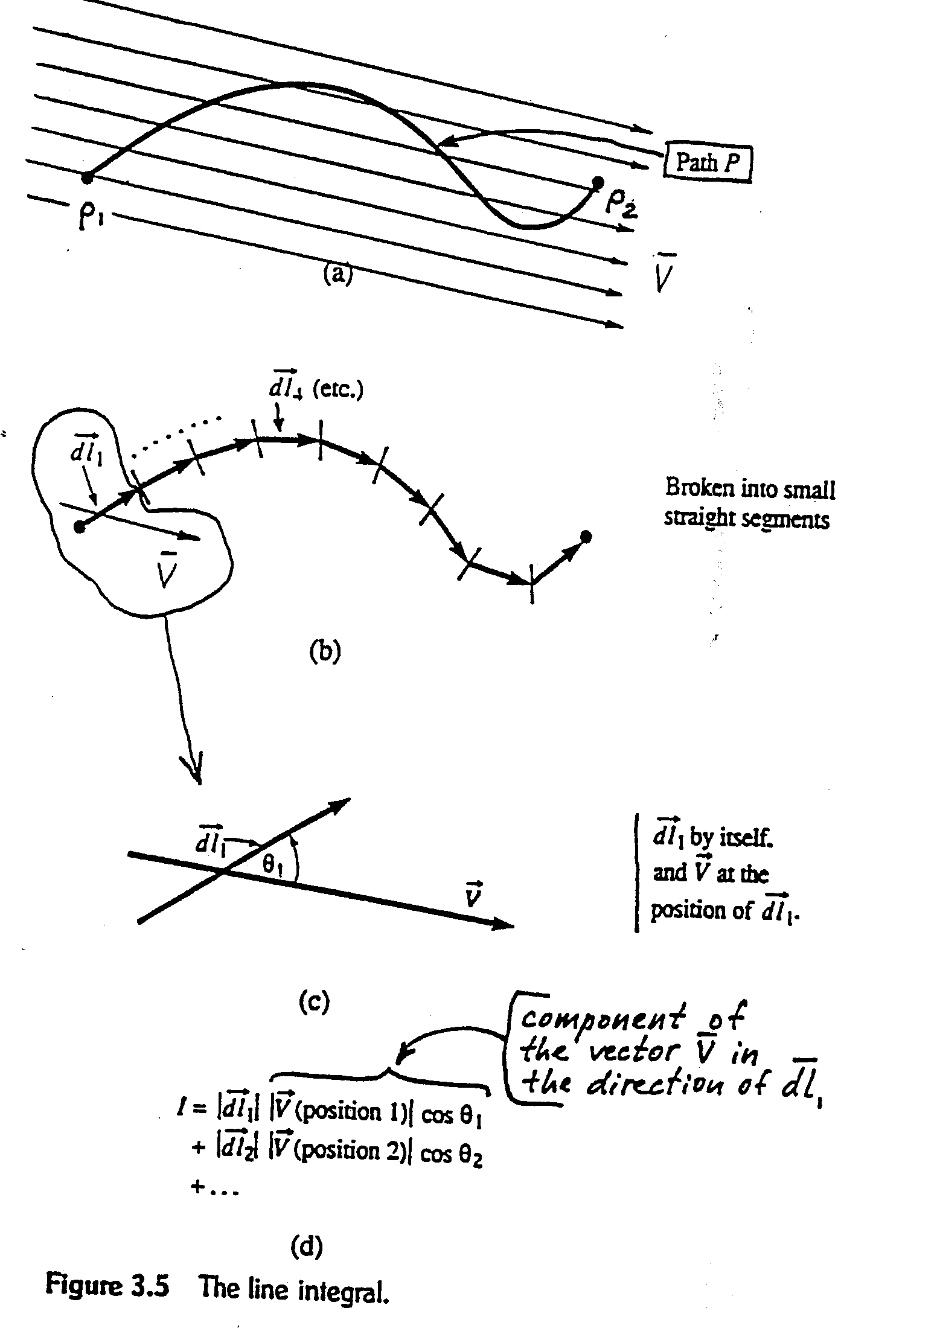
Review of Vector Analysis

Slide 24
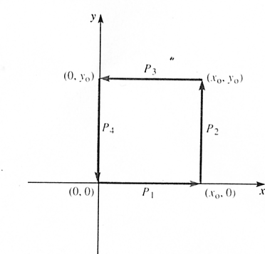
Review of Vector Analysis
Example. The vector is given by where V_{o}
is a constant. Find the line integral
where the path P is the
closed square path in
the sketch.
It is convenient to break the
path P up into the four
parts P₁, P₂, P₃ , and P₄.

Slide 25
Review of Vector Analysis
For segment P₁, Thus
For segment P₂ , and

Slide 26
Review of Vector Analysis
For segment P₃,
For segment P₄ ,

Slide 27
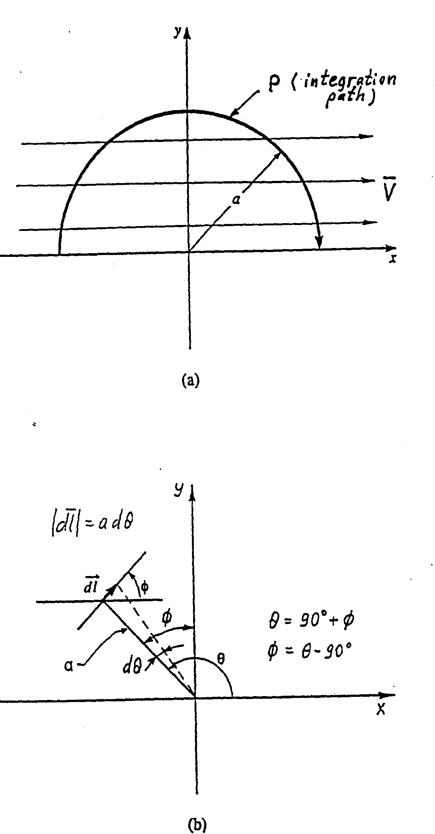
Review of Vector Analysis
Example. Let the vector field be given by .
Find the line integral of over the semicircular path of radius a shown
below:
Consider the contribution of the path segment located at the angle
P₁
P₂
We will integrate from θ=0 to θ=180º

Slide 28
The same result would be obtained if we integrated from P₁ to P₂ along the x-axis ( ), so it is independent of the integration path (uniform field is conservative).

Slide 29
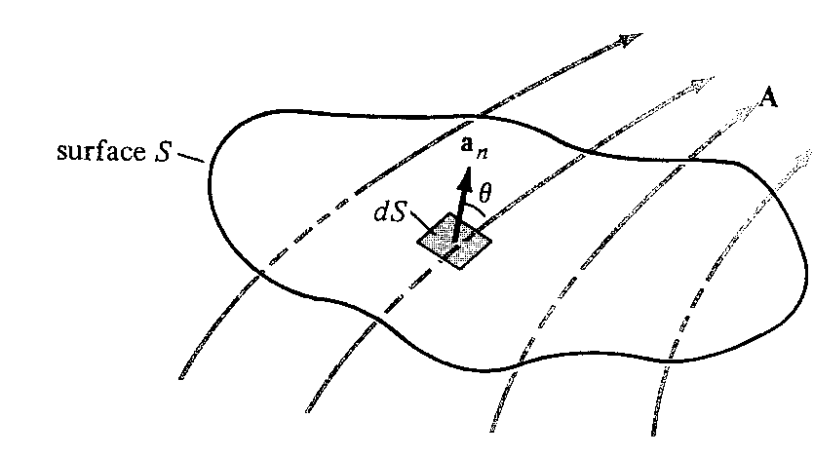
Review of Vector Analysis
Surface Integrals
Surface integration amounts to adding up normal
components of a vector field over a given surface S.
We break the surface S into small surface elements and
assign to each element a vector
is equal to the area of the surface element
is the unit vector normal (perpendicular) to the surface
element
The flux of a vector field V through surface S

Slide 30
Review of Vector Analysis
(If S is a closed surface, is by convention directed
outward)
Then we take the dot product of the vector field at the
position of the surface element with vector . The result is
a differential scalar. The sum of these scalars over all the
surface elements is the surface integral.
is the component of in the direction of (normal to the surface).
Therefore, the surface integral can be viewed as the flow (or flux) of the vector field through the surface S (the net outward flux in the case of a closed surface).

Slide 31
The Radius Vector
Review of Vector Analysis
A point P in Cartesian coordinates may be represented by
specifying (x, y, z). The radius vector (or position vector) of
point P is defined as the directed distance from the origin O
to P; that is,
The unit vector in the direction of is

Slide 32
Review of Vector Analysis
Example. Let be the radius vector
The surface S (square plane perpendicular to the z-axis) is defined by
The normal to the surface is directed in the +z direction
Find

Slide 33
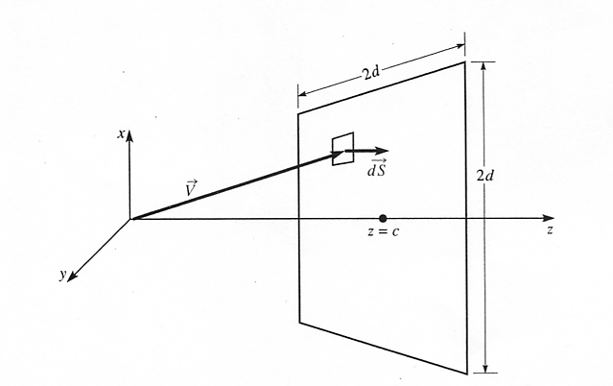
Review of Vector Analysis
0
θ
Surface S
V-vector is not perpendicular to the screen S, except at one point (z=c) on the z axis. Normal component of V passes through the screen S, while the tangential component slides along the screen. Only the normal component is needed for finding the surface integral.

Slide 34
Review of Vector Analysis
ds = (dxdy)e_{z}
z = c
I_{s} = 4d²c

Slide 35
Maxwell’s Equations

Slide 36
Review of Vector Analysis
Introduction to Differential Operators
An operator acts on a field (a function of spatial coordinates) to produce some function of the field.
It is like a function of a function.
If O is an operator acting on a function f(x) of the single
variable x , the result is written O[f(x)]; and means that
first f acts on x and then O acts on f.
Example. f(x) = x² and the operator O is (d/dx+2)
O[f(x)]=d/dx(x²) + 2(x²) = 2x + 2(x²) = 2x(1+x)

Slide 37
Review of Vector Analysis
Vector fields are often specified in terms of their rectangular components:
where , , and are three scalar functions of position. There are operators expressed in terms of
, , and .
For example, the divergence operator is defined as

Slide 38
Review of Vector Analysis
Example: .
Evaluate at the point x = 1, y = -1, z = 2.
Clearly the divergence operator is a scalar operator.

Slide 39
2. REVIEW OF VECTOR ANALYSIS - 5 lectures
- Vector addition and subtraction
- Dot and cross products
- Line and surface integrals
- Introduction to differential operators
- Cartesian, cylindrical, and spherical
coordinates

Slide 40
Review of Vector Analysis
1. - gradient, acts on a scalar to produce a vector
2. - divergence, acts on a vector to produce a scalar
3. - curl, acts on a vector to produce a vector
4. - Laplacian, acts on a scalar to produce a scalar
Each of these will be defined in detail in the subsequent sections.

Slide 41
Review of Vector Analysis
Vector fields are often specified in terms of their rectangular components:
where , , and are three scalar functions of position. There are operators expressed in terms of
, , and .
For example, the divergence operator is defined as

Slide 42
Review of Vector Analysis
Coordinate Systems
In order to define the position of a point in space, an appropriate coordinate system is needed. A considerable amount of work and time may be saved by choosing a coordinate system that best fits a given problem. A hard problem in one coordinate system may turn out to be easy in another system.
We will consider the Cartesian (x,y,z), the circular cylindrical , and the spherical
coordinate systems. All three are orthogonal (the coordinates are mutually perpendicular).

Slide 43
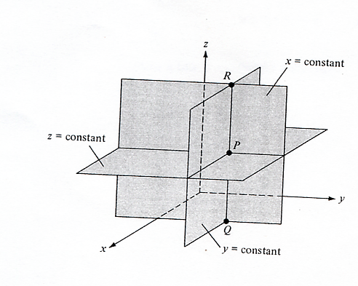
Review of Vector Analysis
Cartesian coordinates (x,y,z)
The ranges of the coordinate variables are
A vector in Cartesian coordinates can be written as
The intersection of three orthogonal infinite planes
(x=const, y= const, and z = const)
defines point P.
Constant x, y and z surfaces

Slide 44
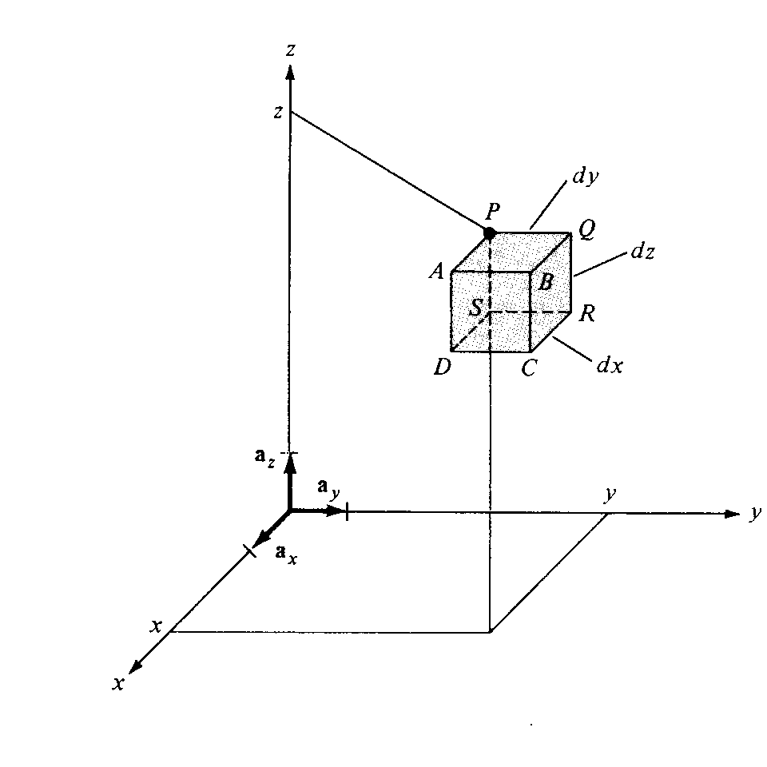
Review of Vector Analysis
Differential elements in the right handed Cartesian coordinate system

Slide 45
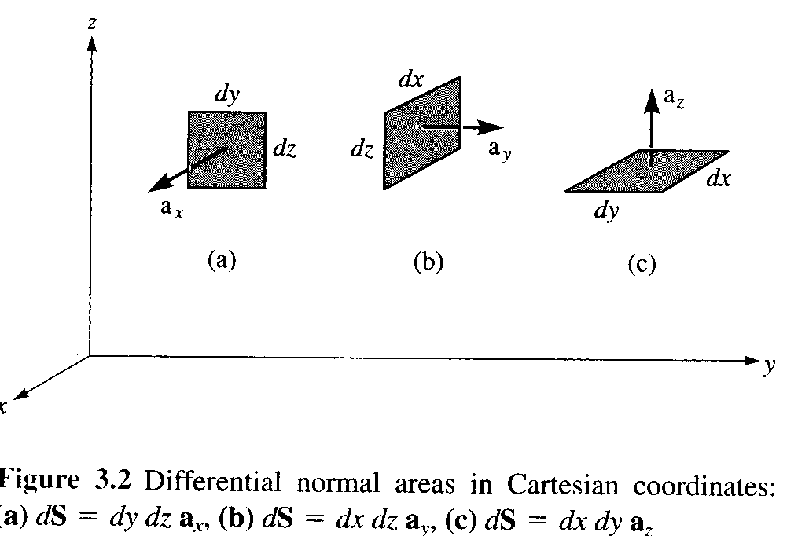
Review of Vector Analysis

Slide 46
Review of Vector Analysis
Cylindrical Coordinates .
- the radial distance from the z–axis
- the azimuthal angle, measured from the x- axis in the xy–plane
- the same as in the Cartesian system.
A vector in cylindrical coordinates can be written as
Cylindrical coordinates amount to a combination of
rectangular coordinates and polar coordinates.

Slide 47
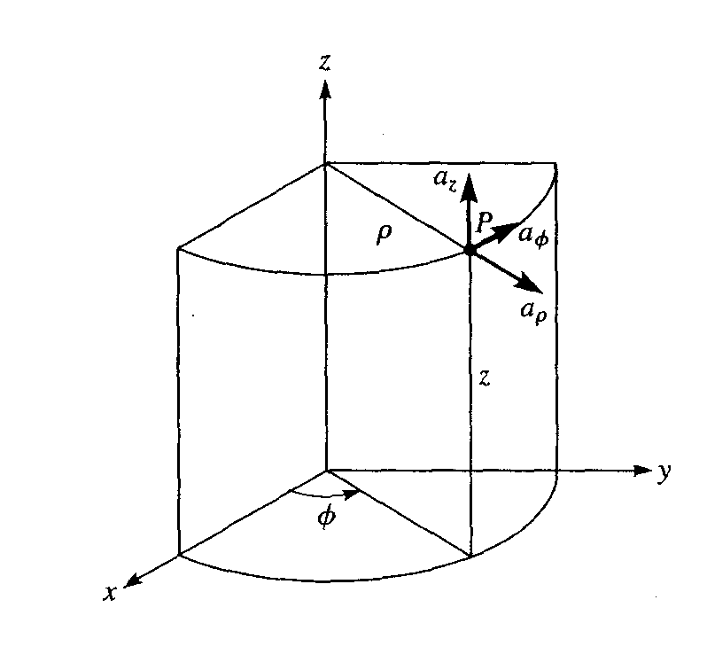
Review of Vector Analysis
Point P and unit vectors in the cylindrical coordinate system
(“a” here is the same as “e”)

Slide 48
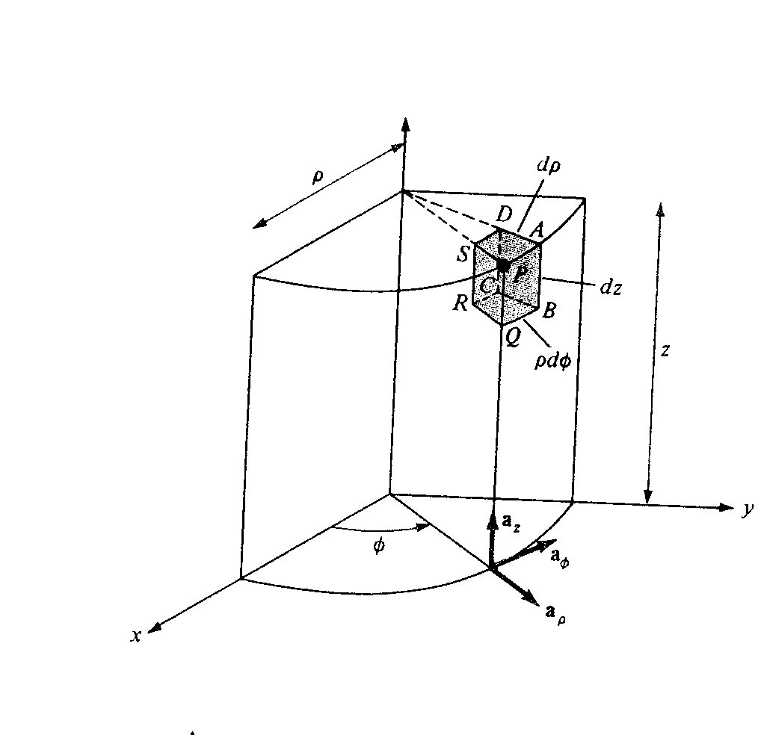
Review of Vector Analysis
Metric coefficient
Differential elements in cylindrical coordinates

Slide 49
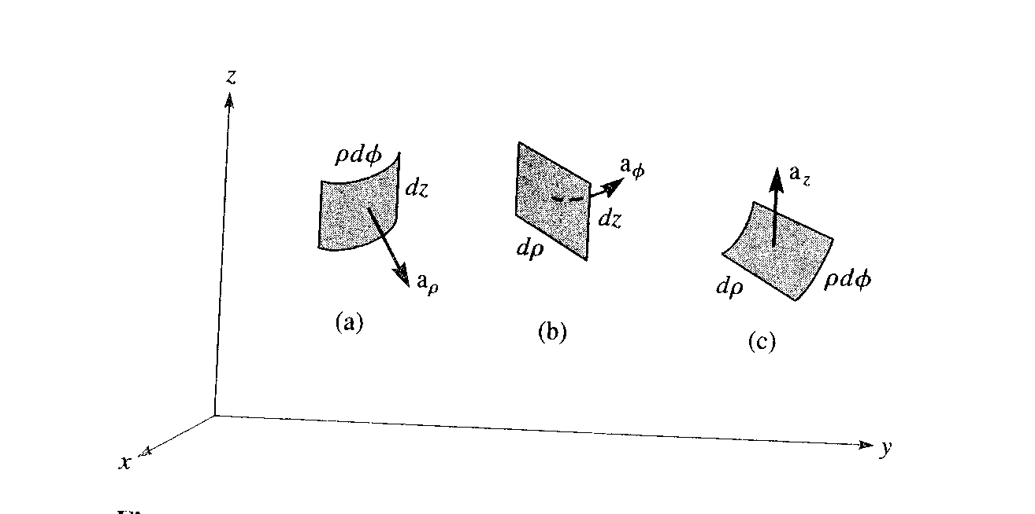
Review of Vector Analysis
Cylindrical surface
( = const)
Planar surface
( = const)
Planar surface
(z = const)

Slide 50
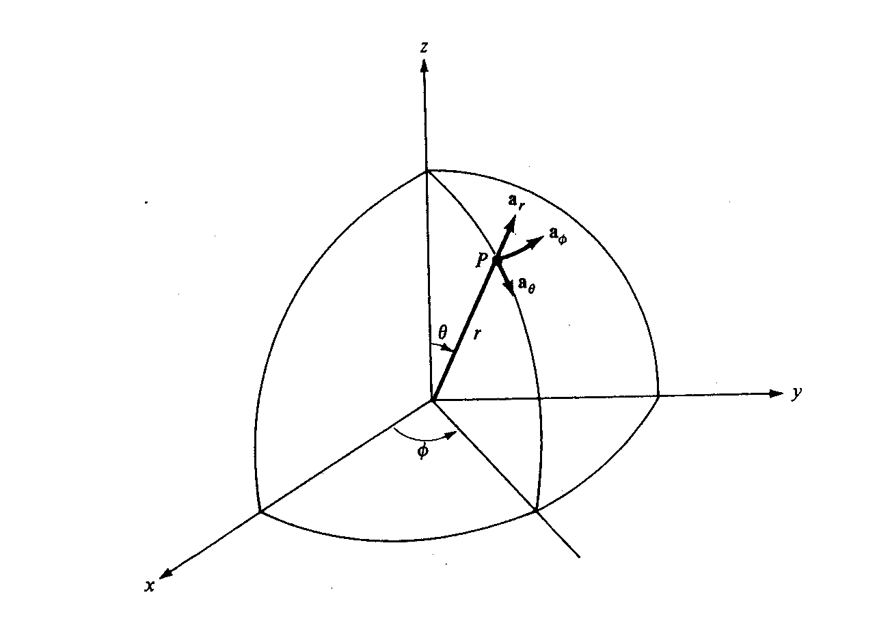
Review of Vector Analysis
Spherical coordinates .
- the distance from the origin to point P
- the angle between the z-axis and the
radius vector of P
- the same as the azimuthal angle in the cylindrical coordinates

Slide 51
Review of Vector Analysis
Point P and unit vectors in spherical coordinates
A vector in spherical coordinates may be written as

Slide 52
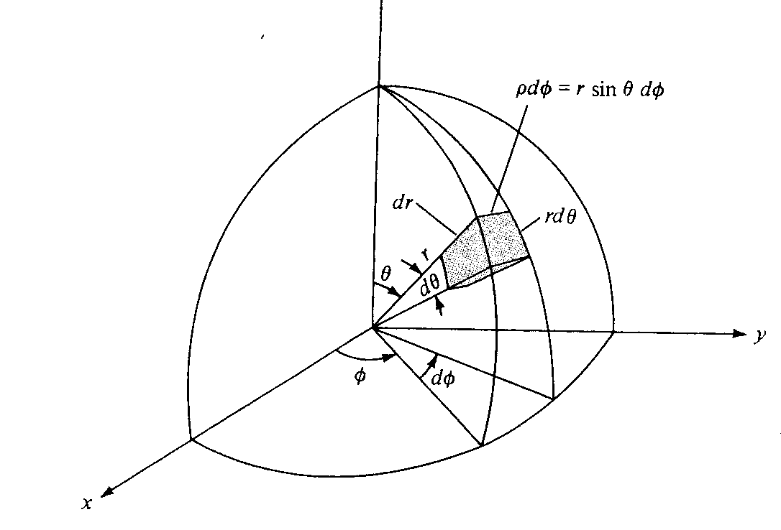
Review of Vector Analysis
Differential elements in the spherical coordinate system

Slide 53
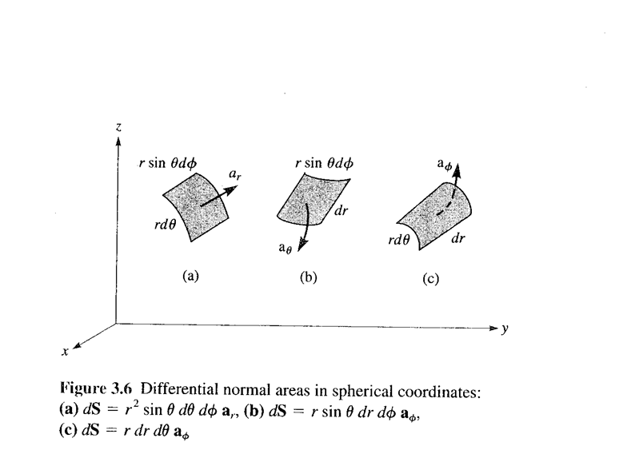
Review of Vector Analysis
Spherical surface
Conical surface
Planar surface

Slide 54
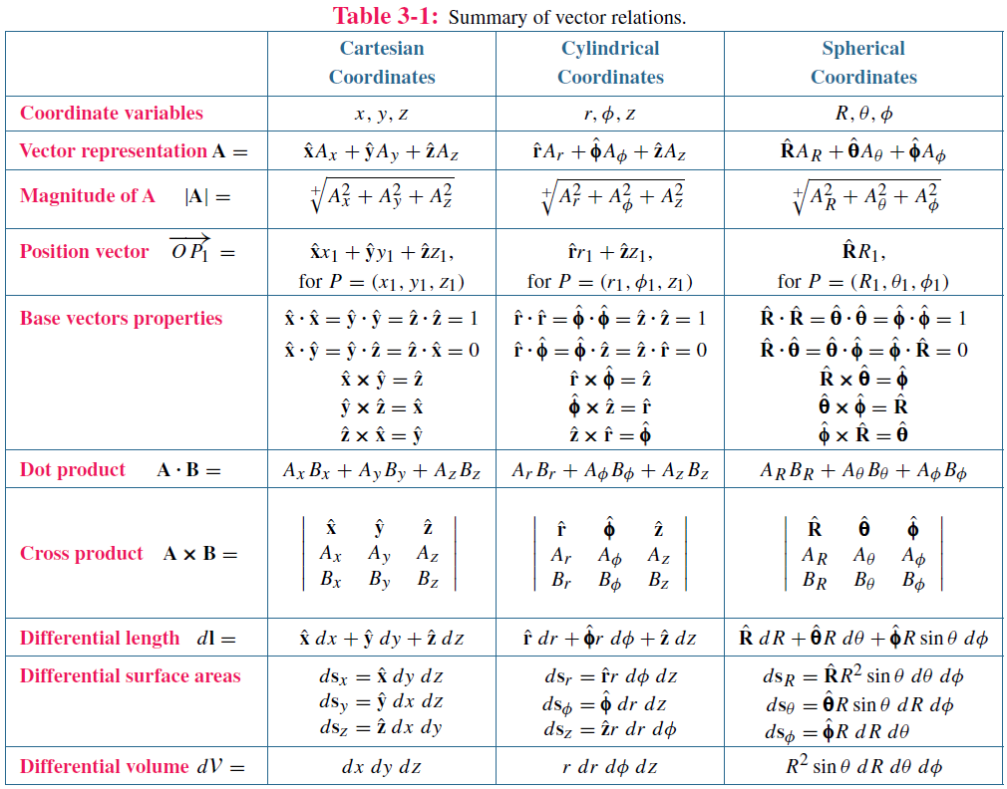
(Radius vector)
(Base vector = Unit vector)

Slide 55
Converting vectors from one coordinate system to another
Coordinate variables: x, y, z,
Unit vectors: e_{x} , e_{y} , e_{z}
Scalar components: V_{x}, V_{y}, V_{z}
Need to get rid of all the quantities of the original coordinate system. There are two ways to go:
(a) Convert all unit vectors
(b) Convert all coordinate variables
(a) Find scalar components for the new coordinate system in terms of scalar components in the old coordinate system and assign appropriate unit vectors
(b) Convert all coordinate variables

Slide 56
Example. Convert vector A from rectangular to cylindrical coordinate system (Table 3-2 of Ulaby).
A = (x + y)e_{x} A_{x} = (x + y), A_{y} = 0, A_{z} = 0
Approach 1.
(a) e_{x} = e_{ρ} cosϕ - e_{ϕ} sinϕ (Column 2, Row 2)
(b) x = ρcosϕ, y = ρsinϕ (Column 1, Row 2)
A = (ρcosϕ + ρsinϕ)(e_{ρ} cosϕ - e_{ϕ} sinϕ)
= (ρcosϕ + ρsinϕ)cosϕ e_{ρ} - (ρcosϕ + ρsinϕ)sinϕ e_{ϕ}
Only Columns 1 and 2 in Row 2 of Table 3-2 are needed. Column 3 (scalar components) is not used in Approach 1.

Slide 57
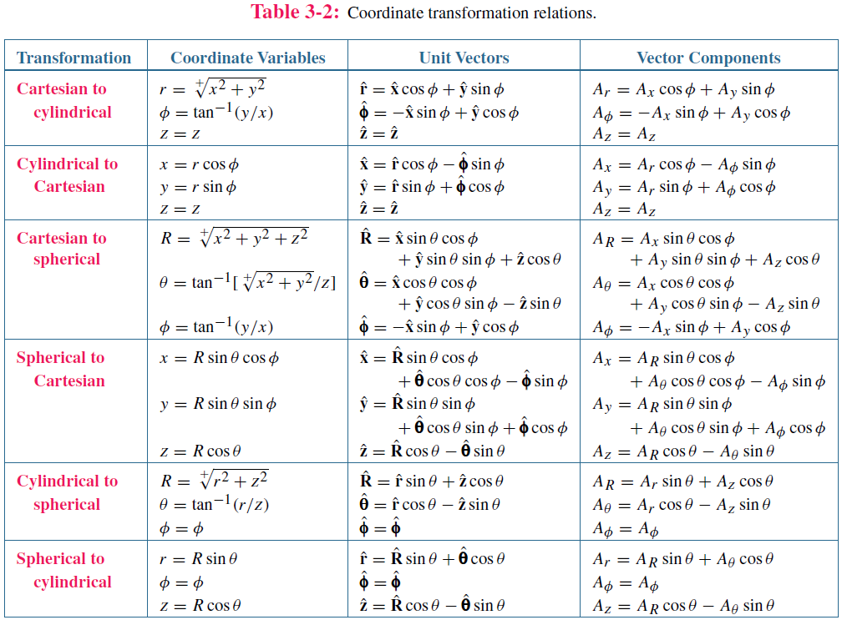
Red box – Approach 1
Blue box – Approach 2
Column 1
Column 2
Column 3
Scalar
Row 1
Row 2

Slide 58
Approach 2. A = (x + y)e_{x} A_{x} = (x + y), A_{y}= 0, A_{z} = 0
A = A_{ρ}e_{ρ} + A_{ϕ}e_{ϕ} + A_{z}e_{z}
(a) A_{ρ} = A_{x}cosϕ + A_{y}sinϕ A_{ϕ} = -A_{x}sinϕ + A_{y}cosϕ
(Column 3, Row 1 of Table 3-2)
(b) A_{x} = (x + y) = (ρcosϕ + ρsinϕ) (Column 1, Row 2)
A = (ρcosϕ + ρsinϕ)cosϕ e_{ρ} - (ρcosϕ + ρsinϕ)sinϕ e_{ϕ}
Only Column 3 in Row 1 and Column 1 in Row 2 of Table 3-2 are needed. Column 2 (unit vectors) is not used in Approach 2.

Slide 59
Red box – Approach 1
Blue box – Approach 2
Column 1
Column 2
Column 3
Scalar
Row 1
Row 2

Slide 60
(Radius vector)
(Base vector = Unit vector)

Slide 61
Time Table, updated on 09/21/20
Course Section | Number of Lectures | HA Given | HW Due | Chapter(s) in Text (Ulaby)
Introduction | 1 | - | - | 1
1. Transmission Lines | 7 | 09/21 | 09/23 | 2
2. Review of Vector Analysis | 5 | 10/05 | 10/07 | 3
3. Electrostatics | 7 | 10/19 | 10/21 | 4
4. Magnetostatics | 5 | 11/02 | 11/04 | 5
5. Time-Varying Fields | 8 | 11/20 | 11/23 | 6, 5.7, 7.5
6. Electromagnetic Waves | 6 | 12/07 | 12/09 | 7, 8
Review | 1 | - | - | 1-8
Final Exam (format to be announced later) Group 18C | - | - | 12/18 (12:30-2:30 p.m.) | 1-8

Slide 62
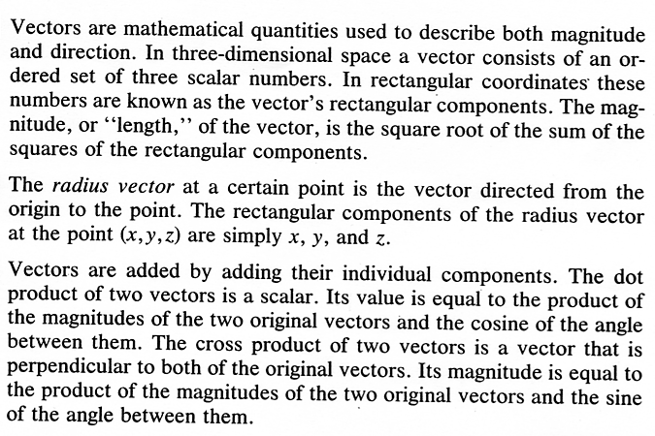
Review of Vector Analysis
POINTS TO REMEMBER
1.
2.
3.

Slide 63
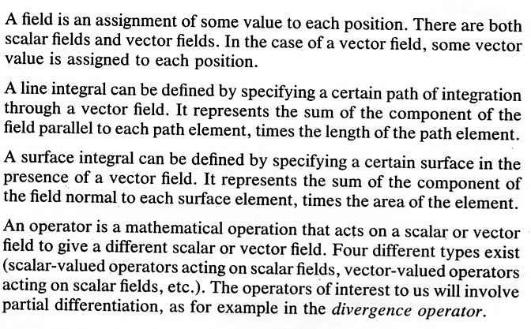
Review of Vector Analysis
4.
5.
6.
7.

Slide 64
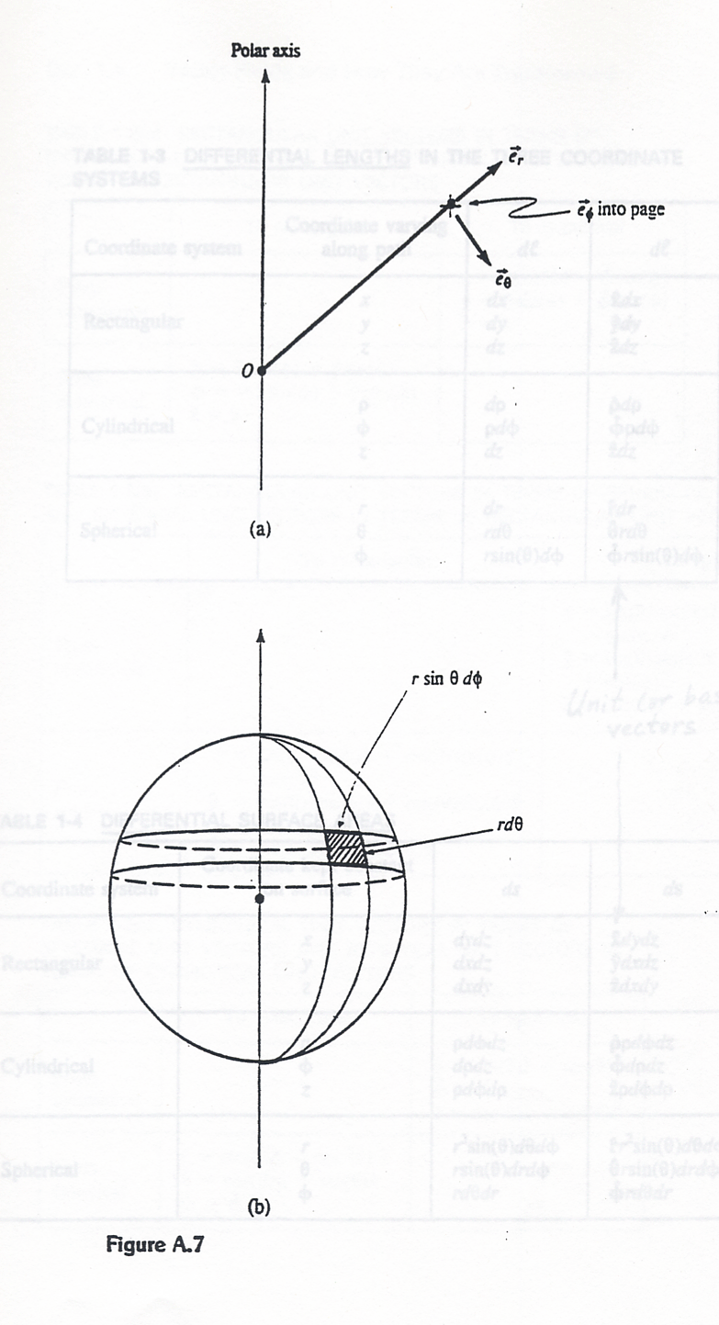
Review of Vector Analysis

Slide 65
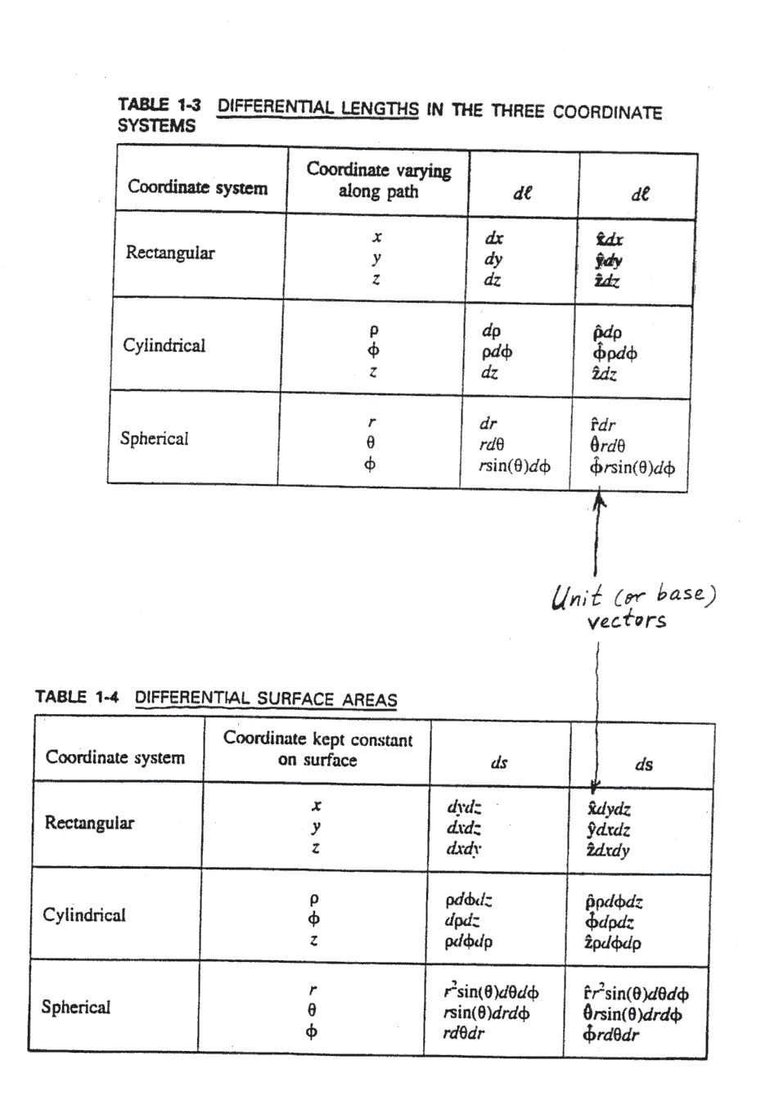
Review of Vector Analysis

Slide 66
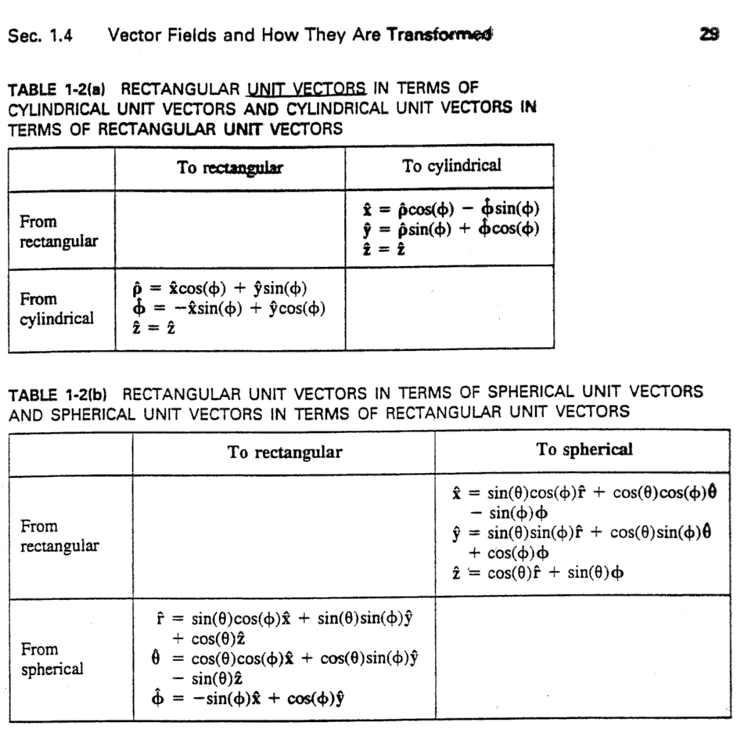
Review of Vector Analysis

Slide 67
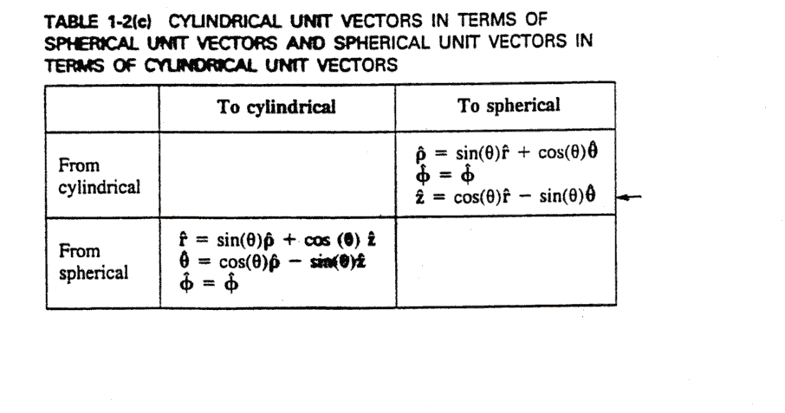
Review of Vector Analysis

Slide 68
Review of Vector Analysis
An operator acting on a vector field can produce
either a scalar or a vector.
Example. (the length operator),
Evaluate at the point x=1, y=2, z=-2
Thus, O is a scalar operator acting on a vector field.
Example. , ,
x=1, y=2, z=-2
Thus, O is a vector operator acting on a vector field.

Slide 69
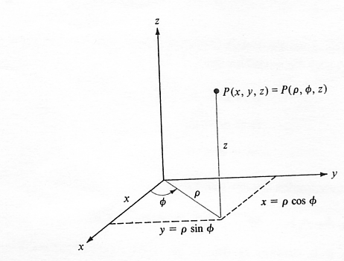
Review of Vector Analysis
Positions in the x-y plane are determined by the values of
Relationship between (x,y,z) and

Slide 70
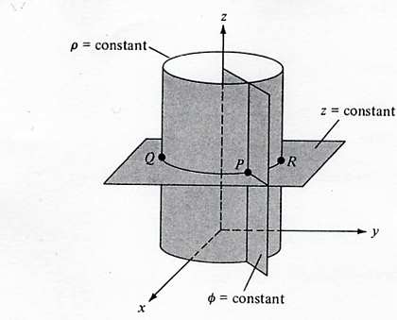
Review of Vector Analysis
semi-infinite plane with its edge along the z - axis
Constant surfaces

Slide 71
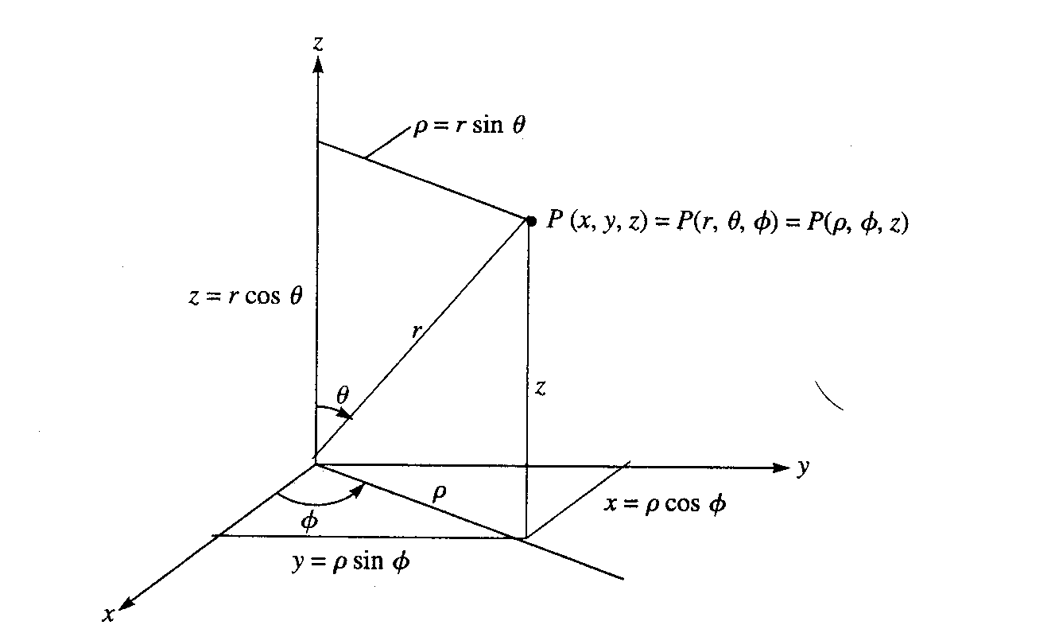
Review of Vector Analysis
Relationships between space variables

Slide 72
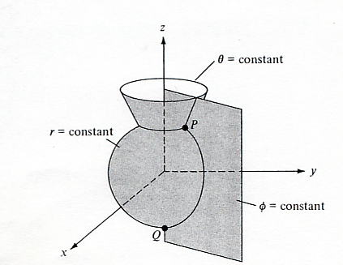
Review of Vector Analysis
Constant surfaces

