Slide 1
EEL 3472C, Fundamentals of Electromagnetic Fields
Fall 2020
REVIEW
(Course Highlights)

Slide 2
Time Table, updated on 12/07/20
Course Section | Number of Lectures | HA Given | HW Due | Chapter(s) in Text (Ulaby)
Introduction | 1 | - | - | 1
Transmission Lines (TEM field waves can be represented by V and I (scalars) waves) | 7 | 09/21 | 09/23 | 2
2. Review of Vector Analysis | 5 | 10/05 | 10/07 | 3
3. Electrostatics | 7 | 10/19 | 10/21 | 4
4. Magnetostatics | 5 | 11/02 | 11/04 | 5
5. Time-Varying Fields | 8 | 11/20 | 11/23 | 6, 5.7, 7.5
6. Electromagnetic Waves (TEM) | 6 | 12/07 | 12/09 | 7, 8
Review | 1 | - | - | 1-8
Final Exam (via Honorlock) Group 18C | - | - | 12/18 (F) (12:30-2:30 p.m.) | 1-8 (compre-hensive)
5 problems (Sections 1, 3, 4, 5, and 6), 24 min for each

Slide 3
Final exam (via Honorlock) is comprehensive and accounts for 20% of the overall grade for the course. The final exam is graded by the TA and reviewed by the Instructor. Problems on the final exam are of the same level of difficulty as those on the home assignments (so, review your Homeworks; also the assigned sections of the textbook).

Slide 4
READING ASSIGNMENT FOR SECTION 6 (Electromagnetic Waves) - EXAMPLE Textbook (Ulaby and Ravaioli): In Ch. 7, Sections 7.1, 7.2, 7.3 (may skip subsection 7.3.3), 7.4, 7.6, Chapter 7 Summary (pp. 346-347); in Ch. 8, Section 8.1 (including Examples and Exercises in each Section). Course Packet (Lecture Slides, http://www.rakov.ece.ufl.edu/teaching/3472.html): Electromagnetic Waves HA6 (take-home Test 6) will be given on Dec. 7 (M) between 1 and 2 p.m.; HW6 is to be turned in via Canvas not later than Dec. 9 (W), 11:45 a.m.

Slide 5
Overall grade for the course (G) is computed as follows:
G = 0.1(HW1+HW2+...+HW6) + 0.2F + 0.2L,
where HWs are homework grades (60%), F is the Final Exam grade (20%), and L is the Lab grade (20%).

Slide 6
Conversion of percent grade to letter grade:
Percent | Grade | Grade Points
≥90 | A | 4.00
≥86.67 | A- | 3.67
≥83.33 | B+ | 3.33
≥80 | B | 3.00
≥76.67 | B- | 2.67
≥73.33 | C+ | 2.33
≥70 | C | 2.00
≥66.67 | C- | 1.67
≥63.33 | D+ | 1.33
≥60 | D | 1.00
≥56.67 | D- | 0.67
<56.67 | E | 0.00

Slide 7
Final Exam will be administered, via Honorlock, by Ziqin Ding, the TA, on Dec. 18 (Friday), 2020, 12:30 – 2:30 p.m. Open-book policy.
Allowed:
Textbook (Ulaby)
Course Packet (Lecture Slides)
Your own graded Homeworks
Formula sheet (one page, two-sided)
Not allowed:
Cell phones
Any other communication devices
Will need:
Scratch paper
Pen or pencil
Calculator
Google Chrome is the only browser Honorlock supports. Ziqin will provide additional details on the procedure (including submission).

Slide 8
Transmission Lines
Points to Remember
In this chapter we have surveyed several different types of waves on transmission lines. It is important that these different cases not be confused. When approaching a transmission-line problem, the student should begin by asking, “Are the waves in this problem sinusoidal, or rectangular pulses? Is the line ideal, or does it have losses?” Then the proper approach to the problem can be taken.
The ideal lossless line supports waves of any shape (sinusoidal or non-sinusoidal), and transmits them without distortion. The velocity of these waves is . The ratio of the voltage to current is , provided that only one wave is present. Sinusoidal waves are treated using phasor analysis. (A common error is that of attempting to analyze non-sinusoidal waves with phasors. Beware! This makes no sense at all.)
When the line contains series resistance and/or shunt conductance it is said to be lossy. Lossy lines no longer exhibit undistorted propagation; hence a rectangular pulse launched on such a line will not remain rectangular, instead evolving into irregular, messy shapes. However, sinusoidal waves, because of their unique mathematical properties, do continue to be sinusoidal on lossy lines. The presence of losses changes the velocity of propagation and causes the wave to be attenuated (become smaller) as it travels.

Slide 9
Transmission Lines
Lattice (bounce) diagram
This is a space/time diagram which is used to keep track of multiple reflections.
Ideal voltage source
$ρ_{S}$=-1
z
z
$ρ_{R}$=0.5
$ρ_{R}$=-0.5
Voltage at the receiving end

Slide 10
Three approaches to finding electric fields from known sources (discrete or continuous charge distributions)
Electrostatics
Coulomb’s Law
Gauss’ Law
From electric potential:

Slide 11
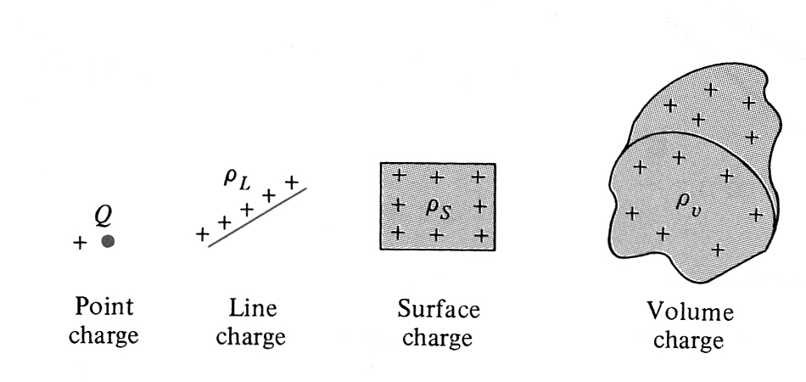
Coulomb’s Law
Electrostatics
Charge density
Various charge distributions.
Consider a charged wire. Charge on an elemental wire segment is so that the charge per unit length . The total electric field is the sum of the field contributions from the individual segments.
If we let we get
Position of the field point
Position of the source point
Line integral

Slide 12
Electrostatics
Gauss’ Law
Any two conductors carrying equal but opposite charges form a capacitor. The capacitance of a capacitor depends on its geometry and on the permittivity of the dielectric separating the conductors.
The capacitance C of a capacitor is defined as the ratio of the magnitude of Q of the charge on one of the plates and the potential difference V between them.
Gaussian
surface
Area A
d
d is very small compared with the lateral dimensions of the capacitor (fringing of at the edges of the plates is neglected). Then V = E x d.
A parallel-plate capacitor.
Cylindrical
Gaussian
Surface
Top face (inside the metal)
Side surface
Boundary
condition on of D_{n} (D_{t}=0)
Bottom face
Close-up view of the upper plate of the capacitor.

Slide 13
G.S.
$$d\overline{S}$$
$$∆A$$
$$Q_{encl}=σ∆A$$
$$Ψ_{out}=\oint_{S}^{ }{ε\overline{E}∙d\overline{S}=Ψ_{top}+Ψ_{bot}+Ψ_{lat}=Q_{encl}=σ∆A}$$
2 Metal
$$(\overline{E}=0)$$
v
Boundary
$$ε\left|\overline{E}\right|∆A$$
1 Dielectric
$$\left|\overline{E}\right|=\frac{σ}{ε}$$
$$d\overline{S}$$
$$\left|\overline{E}\right|∙ε=σ$$
$$\left|\overline{D}\right|=σ$$
$$\overline{E}$$
$$d\overline{S}$$
$$D_{n1}=σ (Diel./Cond\text{.})$$
In general, $D_{n1}−D_{n2}=σ$
$$V=\left|\overline{E}\right|∙d$$
$D_{n1}=D_{n2}$ (Diel./Diel.)
$$C=\frac{Q}{V}=\frac{σA}{\left|\overline{E}\right|∙d}=\frac{σA}{\frac{σd}{ε}}=\frac{εA}{d}$$

Slide 14
Electrostatics
Electrostatic Energy and Potential
Example (continued):
Segment I contributes nothing to the integral because is perpendicular to everywhere along it. As a result, the potential is constant everywhere on Segment I; it is said to be equipotential.
On Segment II, , , and
If we move P2 to infinity (b = ∞) and set V2=0,
where a is the distance between the observation point and the source
point
for line charge
In general,
for surface charge
for volume charge

Slide 15
Electrostatics
Method of Images
A given charge configuration above an infinite grounded perfectly conducting plane may be replaced by the charge configuration itself, its image, and an equipotential surface in place of the conducting plane. The method can be used to determine the fields only in the region where the image charges are not located.
Original problem
Configuration for solving original problem by the method of images. Field lines above the z=0 plane are the same in both cases.
By symmetry, the potential of this plane is zero, which satisfies the boundary conditions of the original problem.

Slide 16
$$+q$$
$$+q$$
$$+q$$
$$+τ$$
$$+ρ$$
$$h$$
$$V=0$$
$$−$$
$$−$$
$$−$$
$$−$$
$$V=0$$
$$\overline{E}=0$$
$$h$$
$$−τ$$
$$−ρ$$
$$−q$$

Slide 17
$$\overline{E}={\overline{E}}_{+}^{ }+{\overline{E}}_{−}^{ }=\frac{q{\overline{r}}_{+}}{4πεr_{+}^{3}}+\frac{−q{\overline{r}}_{−}}{4πεr_{−}^{3}}$$
$${\overline{r}}_{+}^{ }=(x,y,z−h)$$
Vector distances
$${\overline{e}}_{z}^{ }$$
$${\overline{r}}_{+}^{ }$$
$$P(x,y,z)$$
$${\overline{r}}_{−}^{ }=(x,y,z+h)$$
$$(\overline{r}−r^{′})$$
$${\overline{r}}_{+}^{′}=(0,0,h)$$
$$(x,y,z)$$
$$+q$$
$${\overline{r}}_{−}^{ }$$
$$\overline{E}=\frac{q}{4πε}=\left\{\frac{x{\overline{e}}_{x}+y{\overline{e}}_{y}+(z−h){\overline{e}}_{z}}{{\left[x^{2}+y^{2}+{(z−h)}^{2}\right]}^{3/2}}−\frac{x{\overline{e}}_{x}+y{\overline{e}}_{y}+(z+h){\overline{e}}_{z}}{{\left[x^{2}+y^{2}+{(z+h)}^{2}\right]}^{3/2}}\right\}$$
$$V=0$$
$$(0,0,0)$$
x-y
plane
$$If x=0, y=0, z=0,$$
$$\overline{E}=−\frac{q}{2πεh^{2}}{\overline{e}}_{z}$$
$$−q$$
$${\overline{r}}_{−}^{′}=(0,0,−h)$$
$$V=V_{+}{+V}_{−}=\frac{q}{4πεr_{+}}+\frac{−q}{4πεr_{−}}=\frac{q}{4πε}\left\{\frac{1}{{\left[x^{2}+y^{2}+{(z−h)}^{2}\right]}^{1/2}}−\frac{1}{{\left[x^{2}+y^{2}+{(z+h)}^{2}\right]}^{1/2}}\right\}$$
$$\overline{E}=−∇V$$
$$If z=0,$$
$$V=0 for any x and y$$

Slide 18
Three approaches to finding magnetic fields from known sources (steady currents)
Magnetostatics
Biot – Savart’s Law
Ampere’s Law
From magnetic vector potential:

Slide 19
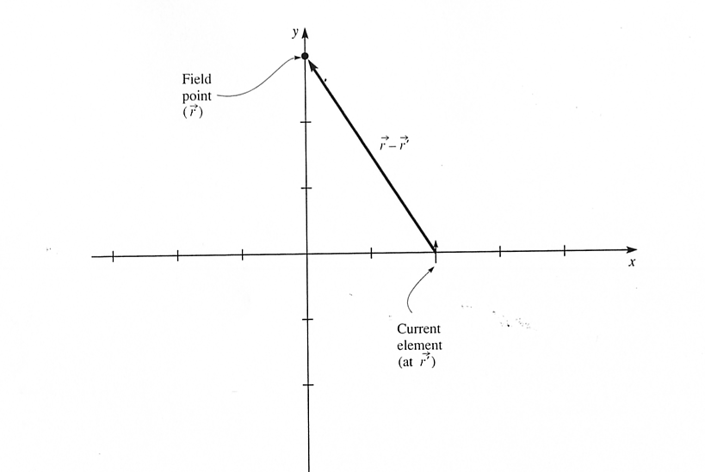
Biot-Savart’s Law
Magnetostatics
Example. A current element is located at x=2 cm, y=0, and
z=0. The current has a magnitude of 150 mA and flows in
the +y direction. The length of the current element is 1 mm.
Find the contribution of this element to the magnetic field
at x=0, y=3 cm, z=0.
3
2
1
1
+z
2
-z
3
4
y
z
x

Slide 20
Biot-Savart’s Law
For a single differential current element Idl:
The field produced by a wire can be found adding up the fields produced by a large number of current elements placed head to tail along the wire (the principle of superposition).

Slide 21
Magnetostatics
Ampere’s Law
Choosing any surface S bounded by the border line L and
applying Stokes’ theorem to the magnetic field intensity
vector , we have
Substituting the magnetostatic curl equation:
we obtain
which is the Ampere’s Law. It states that the circulation
of around a closed path (contour) is equal to the current enclosed by that path.

Slide 22
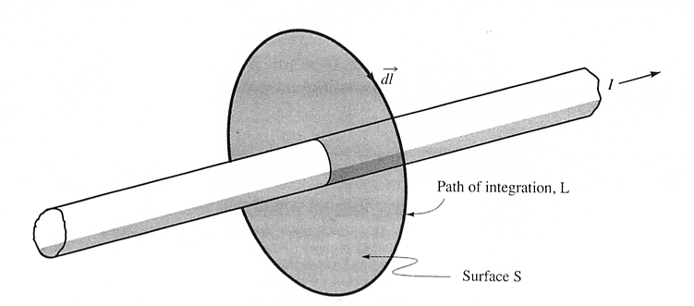
Magnetostatics
R
(Amperian Path)
Ampere’s law is very useful in determining when there is a closed path L around the current I such that the magnitude of is constant over the path.

Slide 23
Magnetostatics
Magnetic Vector Potential
Some electrostatic field problems can be simplified by first
finding the electric potential V that is related to the electric field intensity by
Similarly, some magnetostatic field problems can be simplified by first finding the magnetic vector potential that is related to magnetic flux density by
Electric and magnetic vector potentials are related to sources:
V (electric scalar potential)
(magnetic vector potential
for line current)
V

Slide 24
Magnetic Vector Potential
The contribution to from each differential current element
points in the same direction as the current element that
produces it.
The use of provides a powerful, elegant approach to
solving EM problems (it is more convenient to find by first
finding in antenna problems).
Step 1
Step 2

Slide 25
Electrostatic Field vs. Magnetostatic Field
Field lines form closed loops
G.L.
Conservative →
← A.L.

Slide 26
Time-Varying Fields
General Forms of Maxwell’s Equations
Differential Integral Remarks
1
Gauss’ Law
Nonexistence
of isolated magnetic charge
2
3
Faraday’s Law
4
Ampere’s
Law
In 1 and 2, S is a closed surface enclosing the volume V
In 3 and 4, L is a closed path that bounds the surface S

Slide 27
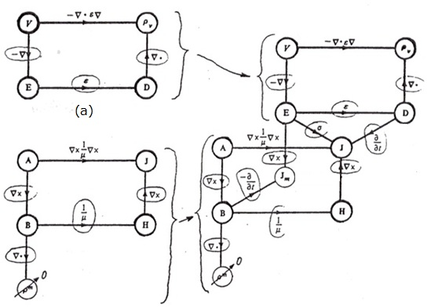
Maxwell’s Equations (continued)
Time-Varying Fields
Electrostatics
Electrodynamics
(a)
Magnetostatics
Ampere’s Law
Faraday’s Law
(b)
(c)
“Free magnetic charge density” ( )
Electromagnetic flow diagram showing the relationship between the potentials and vector fields: (a) electrostatic system, (b) magnetostatic system, (c) electrodynamic system. [Adapted with permission from IEE Publishing Department]

Slide 28
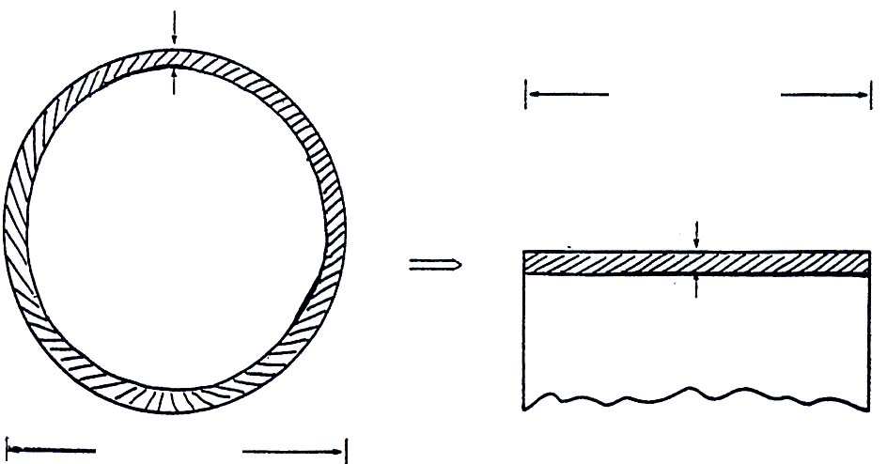
Time-Varying Fields
Time-Varying Fields
Surface Impedance (continued)
Wire (copper) bond
Z=?
Plated metal connections
Substrate
(a)
Thickness of current layer = 0.6 μm = δ
w
x 100 μm
2 r
δ = 0.6 μm
(Internal inductance)
100 μm
(b)
(c)
Finding the resistance and internal inductance of a wire bond. The bond, a length of wire connecting two pads on an IC, is shown in (a). (b) is a cross-sectional view showing skin depth. In (c) we imagine the conducting layer unfolded into a plane.

Slide 29
Electromagnetic Waves
Characteristics of Plane Waves (no losses)
For a plane wave which propagates in the +z direction and
has an electric field pointing in the x direction
where
The time-varying electric field of the wave must, according
to Faraday’s law, be accompanied by a magnetic field.
Thus,
when and is called the characteristic impedance of vacuum.
← phase constant
Wave impedance (intrinsic impedance of the medium)

Slide 30
Electromagnetic Waves
If
, , and the direction of propagation
are all perpendicular to each other.
2. and are in phase.
3. The wave appears to move in the +z direction as though it were a rigid structure moving toward the right
(in exactly the same way as the transmission-line waves).

Slide 31
Perfectly conducting wall:
Electromagnetic Waves
reflection coefficient
transmission coefficient
The incident wave is totally reflected with a phase reversal,
and no power is transmitted across a perfectly conducting
boundary. The conducting boundary acts as a short circuit.
standing wave ratio

Slide 32
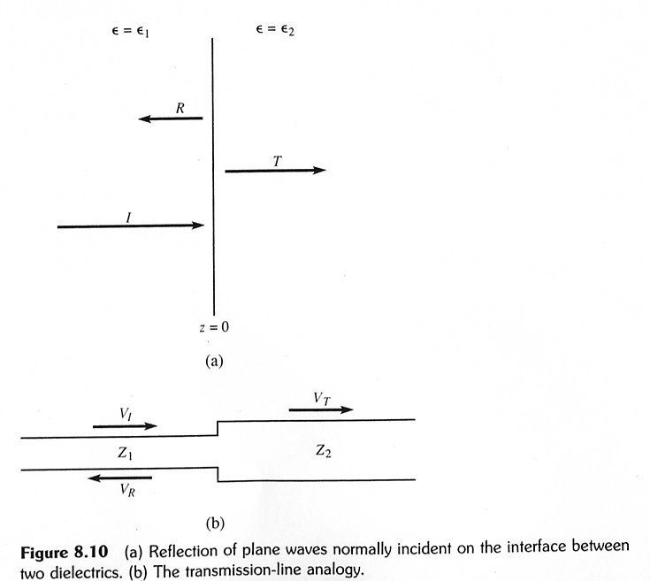
Electromagnetic Waves
Let us next consider the case of a plane wave normally
incident on a dielectric discontinuity

Slide 33
Electromagnetic Waves
At z=0
reflection coefficient
transmission coefficient

Slide 34
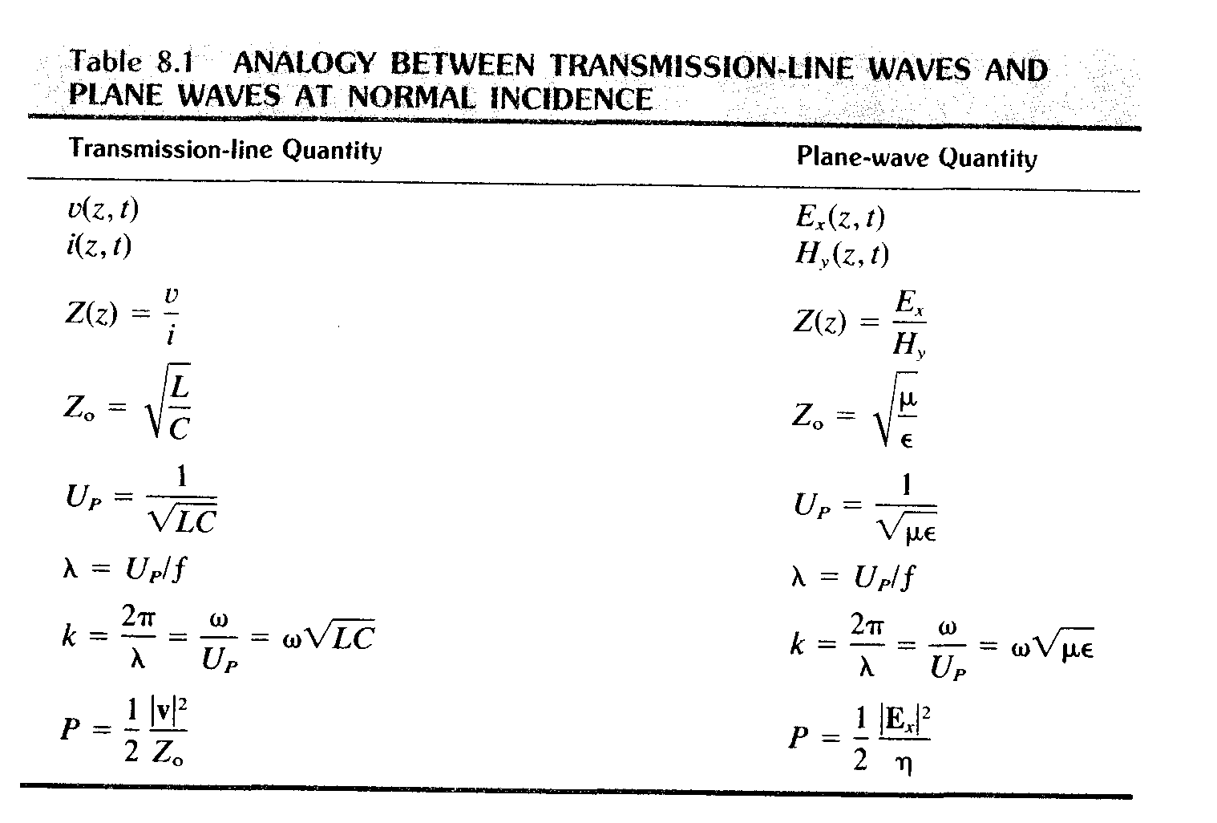
Electromagnetic Waves
No losses!
Input impedance
Wave impedance
Characteristic impedance
Intrinsic impedance of the medium
Time-averaged power density
Time-averaged power density
34

Slide 35
Good Luck!

