Slide 1
Magnetostatics

Slide 2
4. MAGNETOSTATICS - 5 lectures
- Biot-Savart law
- Curl
- Magnetic vector potential
- Ampere's law
- Magnetic force
- Magnetic field boundary conditions

Slide 3
READING ASSIGNMENT FOR SECTION 4 (Magnetostatics) Textbook (Ulaby and Ravaioli): In Ch. 5, Sections 5.1-5.4, 5.6, Chapter 5 Summary (pp. 272-273) Examples: 5-1 to 5-6 Exercises: 5-1 to 5-10 and 5-12 Course Packet (Lecture Slides, http://www.rakov.ece.ufl.edu/teaching/3472.html): Magnetostatics HA4 (take-home Test 4) will be given on Nov. 2 (M) between 1 and 2 p.m.; HW4 is to be turned in via Canvas not later than Nov. 4 (W), 11:45 a.m.

Slide 4
Magnetostatics
Magnetostatics
If charges are moving with constant velocity, a static magnetic (or magnetostatic) field is produced. Thus, magnetostatic fields originate from steady currents (for instance, direct currents in current-carrying wires).
H, A/m – magnetic field intensity
B = μH , Wb/m² (Tesla) – magnetic flux density
μ₀ = 4ϖ x 10⁻⁷ H/m
There are many similarities between the equations for E-field and H-fields. Most of the equations we have derived for the electric fields may be readily used to obtain corresponding equations for magnetic fields if the equivalent analogous quantities are substituted.

Slide 5
Three approaches to finding electric fields from known sources (discrete or continuous charge distributions)
Coulomb’s Law
Gauss’ Law
From electric potential:

Slide 6
Three approaches to finding magnetic fields from known sources (steady currents)
Biot – Savart’s Law
Ampere’s Law
From magnetic vector potential:

Slide 7
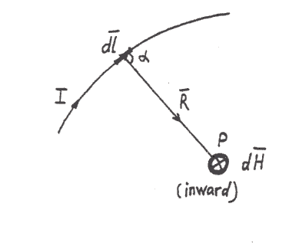
Magnetostatics
Biot – Savart’s Law
Differential current element Idl (at the origin)
The magnetic field intensity dH produced at a point P by the differential current element Idl is proportional to the product of Idl and the sine of the angle between the element and the line joining P to the element and is inversely proportional to the square of the distance R between P and the element.
Right-hand rule
In SI units, , so

Slide 8
Magnetostatics
Using the definition of cross product
we can represent the previous equation in vector form as
The direction of can be determined by the right-hand rule
or by the right-handed screw rule.
If the position of the field point is specified by and the
position of the source point by
where is the unit vector directed from the source point to
the field point, and is the distance between these two
points.

Slide 9
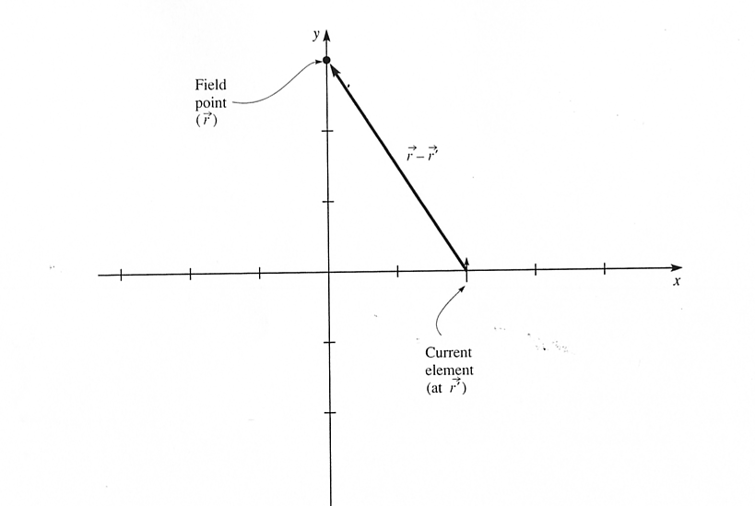
Magnetostatics
Example. A current element is located at x=2 cm, y=0, and
z=0. The current has a magnitude of 150 mA and flows in
the +y direction. The length of the current element is 1 mm.
Find the contribution of this element to the magnetic field
at x=0, y=3 cm, z=0.
3
2
1
1
2
3
4
y
z
x

Slide 10
For a single differential current element Idl:
The field produced by a wire can be found adding up the fields produced by a large number of current elements placed head to tail along the wire (the principle of superposition).

Slide 11
Coulomb’s Law (single point charge Q)
Biot-Savart Law (differential current element Idl)

Slide 12
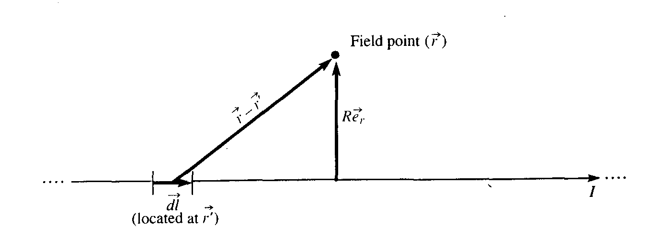
Magnetostatics
Consider an infinitely long straight wire located on the z axis
and carrying a current I in the +z direction. Let a field point
be located at z=0 at a radial distance R from the wire.
R
θ
Z
z
Applies to finite-length (L) conductors when R <<L.

Slide 13
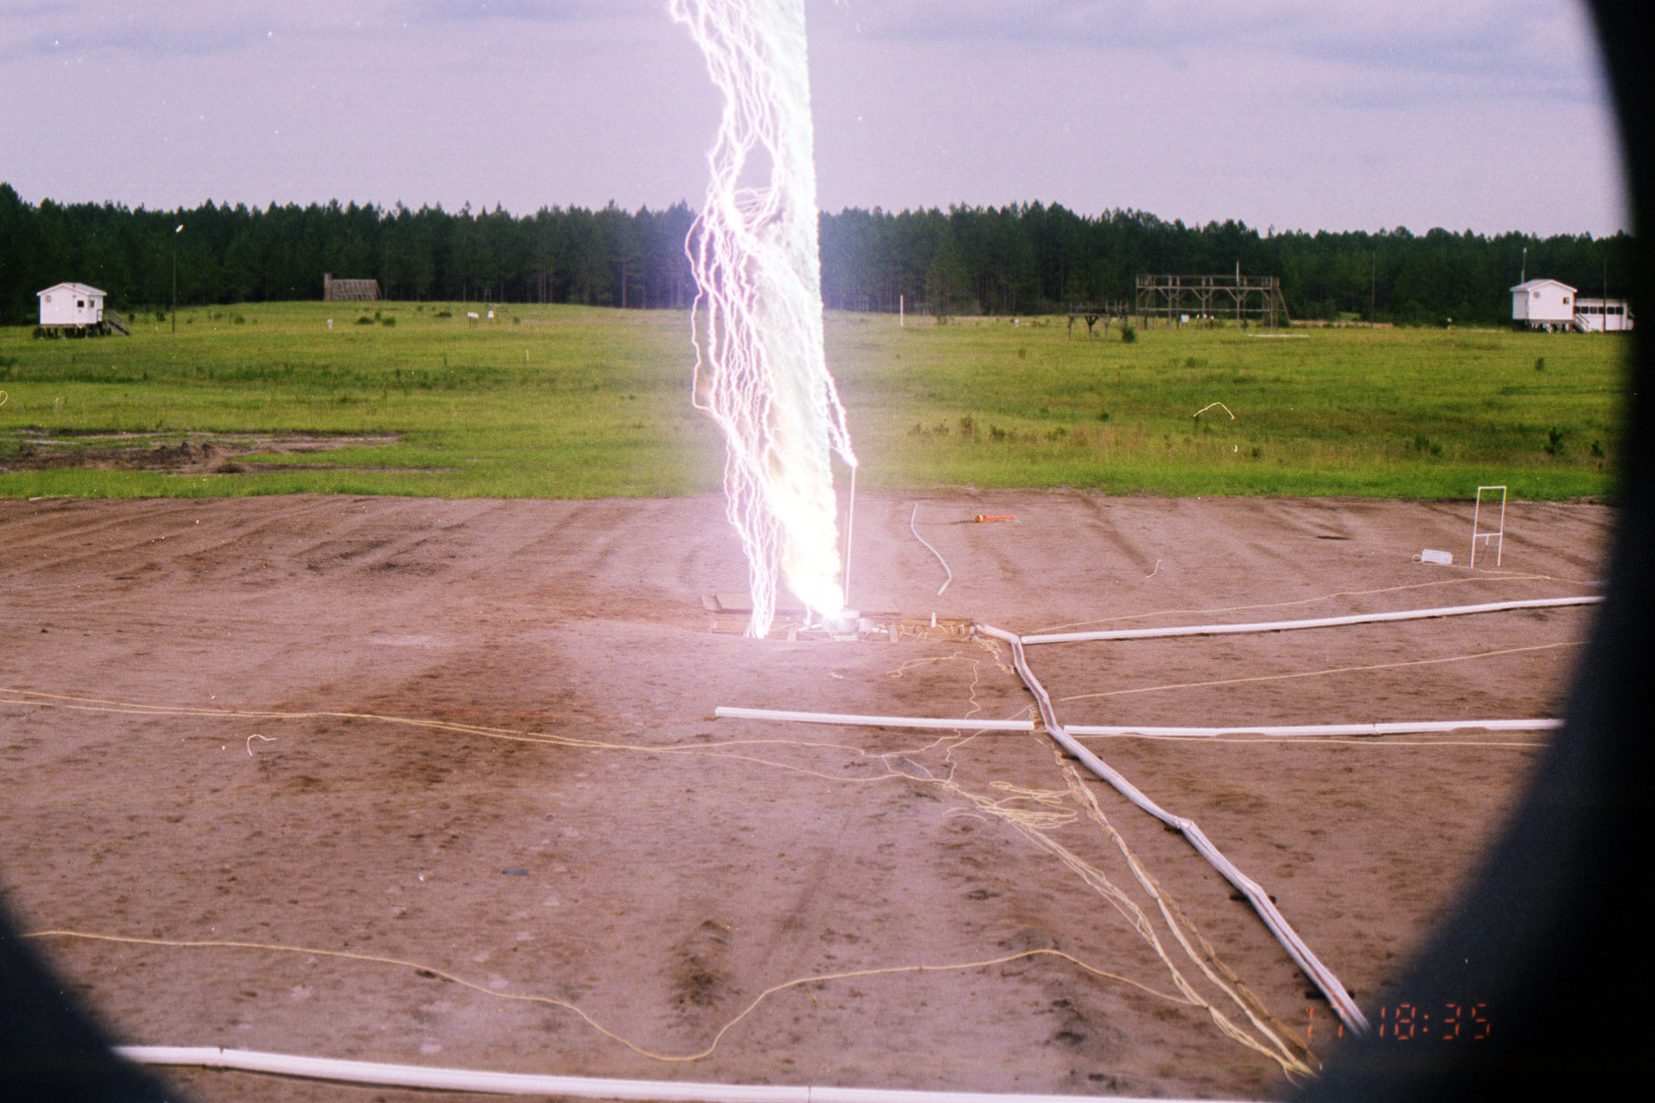
Rocket-and-wire triggered lightning at Camp Blanding, Florida
A lightning strike initiated in 1999 from the underground launcher at the center of
a 70 × 70 m² buried metallic grid
13
Notes:
13

Slide 14
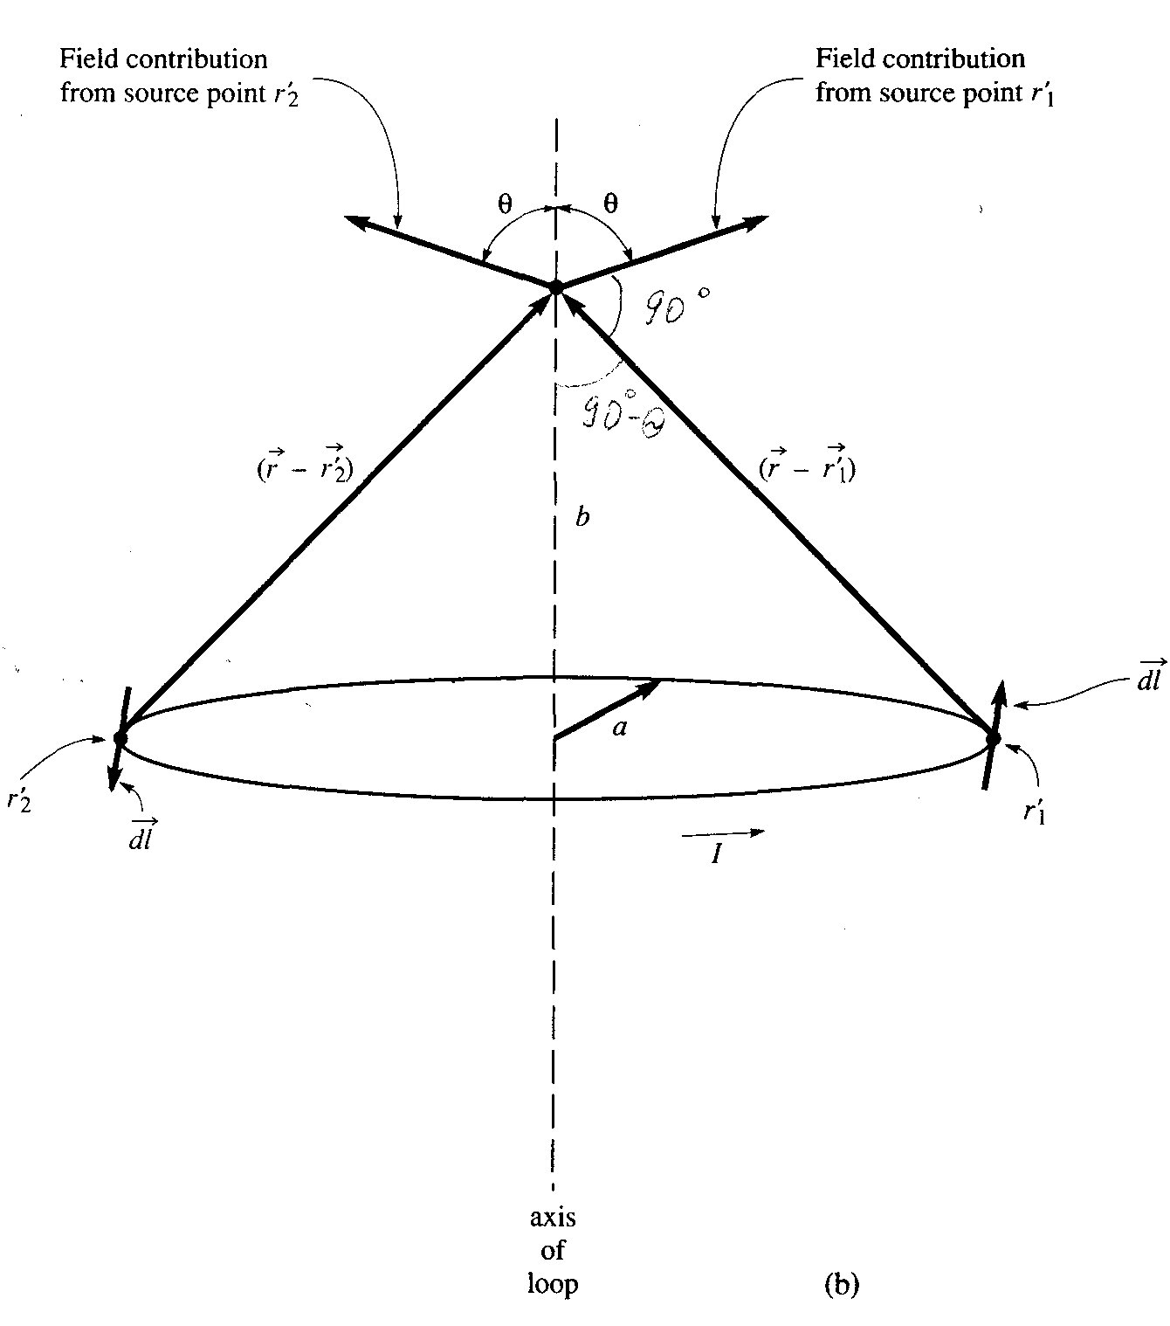
Magnetostatics
Z-axis
(perpendicular to both
and )
The horizontal components of (x-components and y-components) add to zero

Slide 15
Review of Vector Analysis
Differential Operators
1. - gradient, acts on a scalar to produce a vector
2. - divergence, acts on a vector to produce a scalar
3. - curl, acts on a vector to produce a vector
4. - Laplacian, acts on a scalar to produce a scalar

Slide 16
Three approaches to finding magnetic fields from known sources (steady currents)
Biot – Savart’s Law
Ampere’s Law
From magnetic vector potential:

Slide 17
Magnetostatics
The Curl Operator
This operator acts on a vector field to produce another vector
field. Let be a vector field. Then the expression
for the curl of in rectangular coordinates is
where , , and are the rectangular components of
The curl operator can also be written in the form of a
determinant:

Slide 18
Magnetostatics
The physical significance of the curl operator is that it
describes the “rotation” of the field at the point in question.
It may be regarded as a measure of how much the field curls around that point.
The curl of is defined as an axial vector whose magnitude is the maximum circulation of per unit area as the area tends to zero and whose direction is the normal direction of the area when the area is oriented so as to make the circulation maximum.
where the area is bounded by the curve L, and is the
unit vector normal to the surface and whose direction is related to the direction of integration by the right–hand rule.

Slide 19
Time Table, updated on 09/21/20
Course Section | Number of Lectures | HA Given | HW Due | Chapter(s) in Text (Ulaby)
Introduction | 1 | - | - | 1
Transmission Lines (TEM field waves can be represented by V and I (scalars) waves) | 7 | 09/21 | 09/23 | 2
2. Review of Vector Analysis | 5 | 10/05 | 10/07 | 3
3. Electrostatics | 7 | 10/19 | 10/21 | 4
4. Magnetostatics | 5 | 11/02 | 11/04 | 5
5. Time-Varying Fields | 8 | 11/20 | 11/23 | 6, 5.7, 7.5
6. Electromagnetic Waves | 6 | 12/07 | 12/09 | 7, 8
Review | 1 | - | - | 1-8
Final Exam (format to be announced later) Group 18C | - | - | 12/18 (12:30-2:30 p.m.) | 1-8

Slide 20
Coulomb’s Law (single point charge Q)
Direction of E is the same as the direction of vector distance r
Biot-Savart Law (differential current element Idl)
Direction of dH is perpendicular to the vector distance and dl

Slide 21
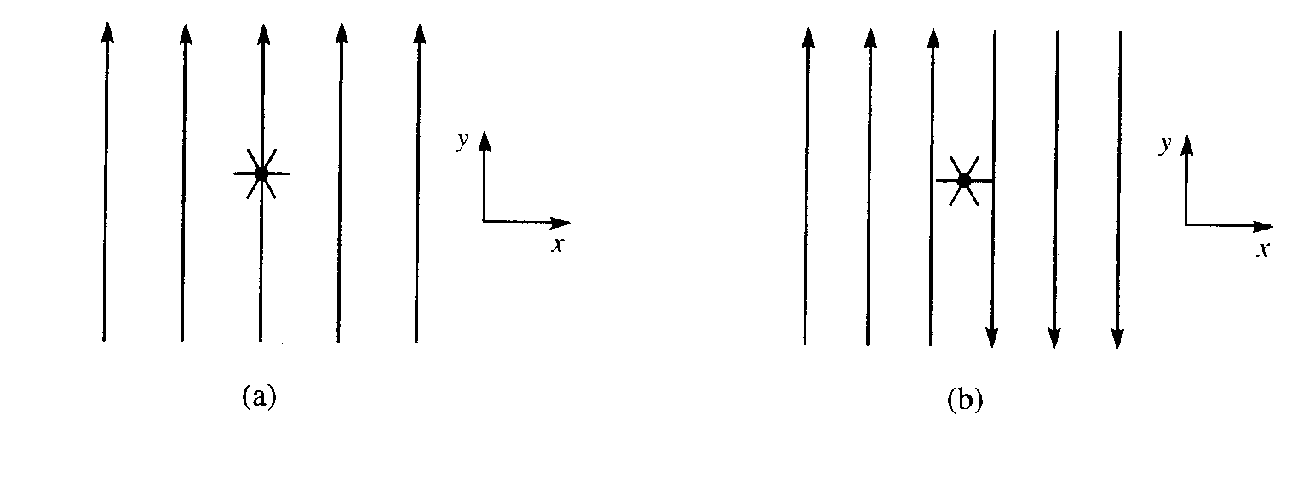
Magnetostatics
A small paddle-wheel with its shaft along the z-axis is used to probe 5 different fields, to evaluate the curl of the field at the position of the paddle-wheel. The z-axis points out of the screen. No rotation means zero curl.
-e_{z}
Along the shaft

Slide 22
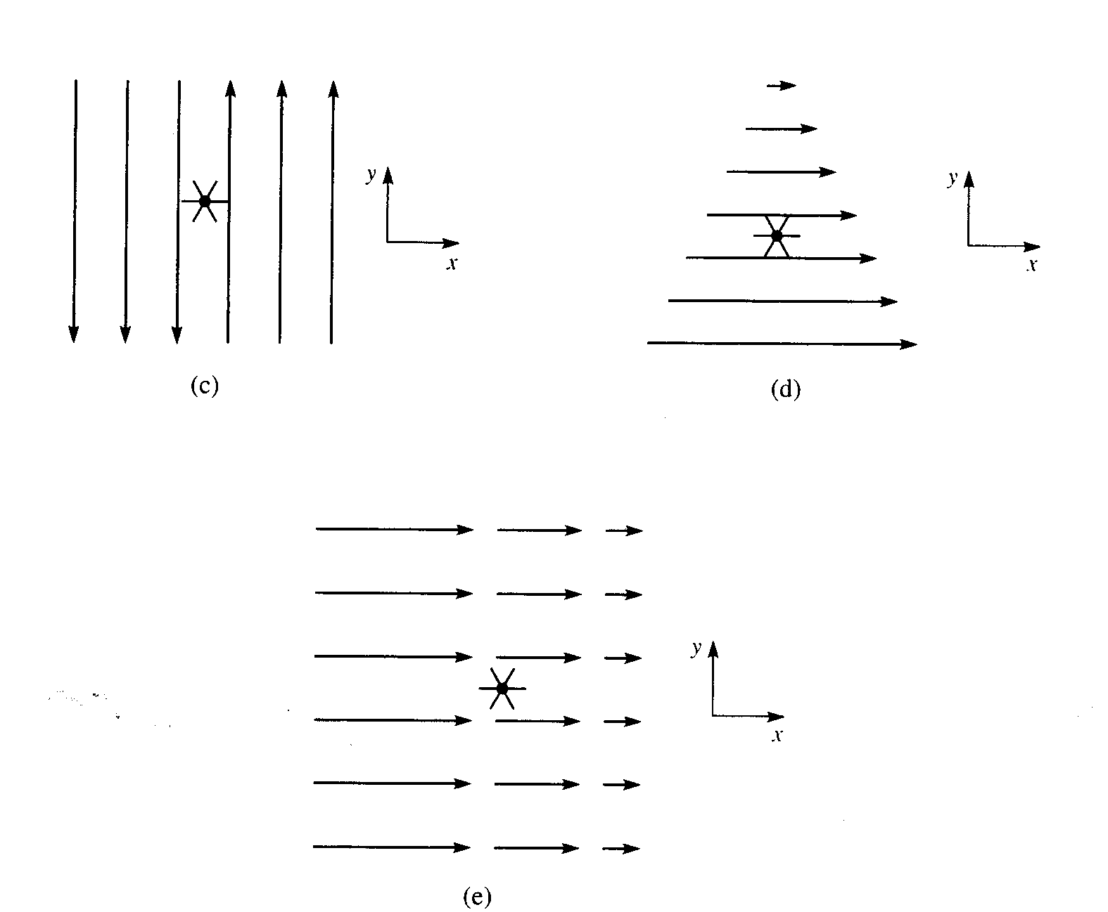
Magnetostatics
+e_{z}
+e_{z}

Slide 23
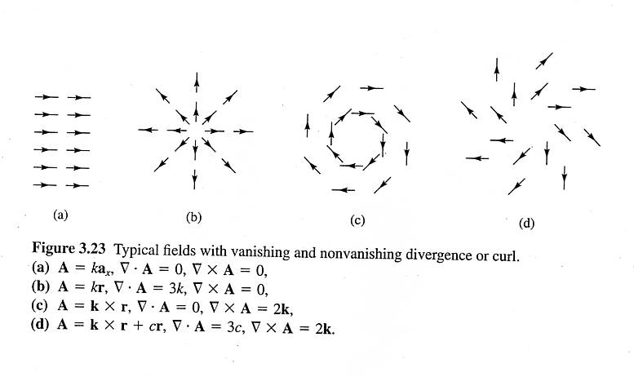
Magnetostatics
Classification of Vector Fields
A vector field is uniquely characterized by its divergence
and curl (Helmholtz’s theorem). The divergence of a vector field is a measure of the strength of its flow source and the curl of the field is a measure of the strength of its vortex source.
$$∇∙\overline{A}≠0 \\ ∇×\overline{A}≠0$$
$$∇∙\overline{A}=0 \\ ∇×\overline{A}=0$$
$$∇∙\overline{A}≠0 \\ ∇×\overline{A}=0$$
$$∇∙\overline{A}=0 \\ ∇×\overline{A}≠0$$
Fields (a) and (b) are irrotational, and fields (a) and (c) are divergenceless.

Slide 24
Magnetostatics
If , then is said to be diversionless.
Such a field has neither source nor sink of
flux (in case (c), field lines form closed loops).
Since (for any ), a diversionless field
can be expressed in terms of another vector (related to sources):
If then is said to be irrotational (or potential, or conservative). The circulation of around a closed path is
identically zero (see cases (a) and (b)).
Since (for any scalar V), an irrotational field
can always be expressed in terms of a scalar field V (related to sources):
Here, A is an arbitrary vector
divB = 0
$$\bar{A}=∇V$$
curlE = 0
(statics only)
Here, A is an arbitrary vector

Slide 25
Magnetostatics
Magnetic Vector Potential
Some electrostatic field problems can be simplified by first
finding the electric potential V that is related to the electric field intensity by
Similarly, some magnetostatic field problems can be simplified by first finding the magnetic vector potential that is related to magnetic flux density by
Electric and magnetic vector potentials are related to sources:
V (electric scalar potential)
(magnetic vector potential
for line current)
V

Slide 26
Magnetic Vector Potential
The contribution to from each differential current element
points in the same direction as the current element that
produces it.
The use of provides a powerful, elegant approach to
solving EM problems (it is more convenient to find by first
finding in antenna problems).
Step 1
Step 2

Slide 27
Magnetostatics
Magnetic Flux Density and Total Flux
The magnetic flux density vector is related to the magnetic
field intensity by the following equation
T (tesla) or Wb/m²
where is the permeability of the medium. Except for
ferromagnetic materials (such as cobalt, nickel, and iron),
most materials have values of very nearly equal to that for vacuum,
H/m (henry per meter)
The magnetic flux through a given surface S is given by
Wb (weber)

Slide 28
4. MAGNETOSTATICS - 5 lectures
- Biot-Savart law
- Curl
- Magnetic vector potential
- Ampere's law
- Magnetic force
- Magnetic field boundary conditions

Slide 29
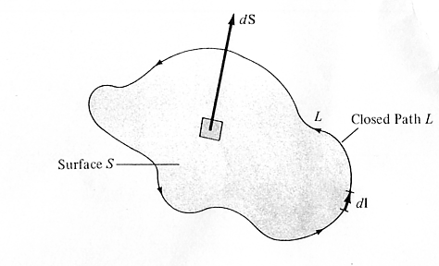
Stokes’ Theorem
Magnetostatics
Stokes’ theorem converts a surface integral of the curl of a
vector to a line integral of the vector, and vice versa.
(The divergence theorem relates a volume integral of the
divergence of a vector to a surface integral of the vector, and
vice versa).
The circulation of around a closed path L is equal to the surface integral of the curl of over the open surface S bounded by L.
The direction of integration around L is related to the direction of by the right-hand rule.

Slide 30
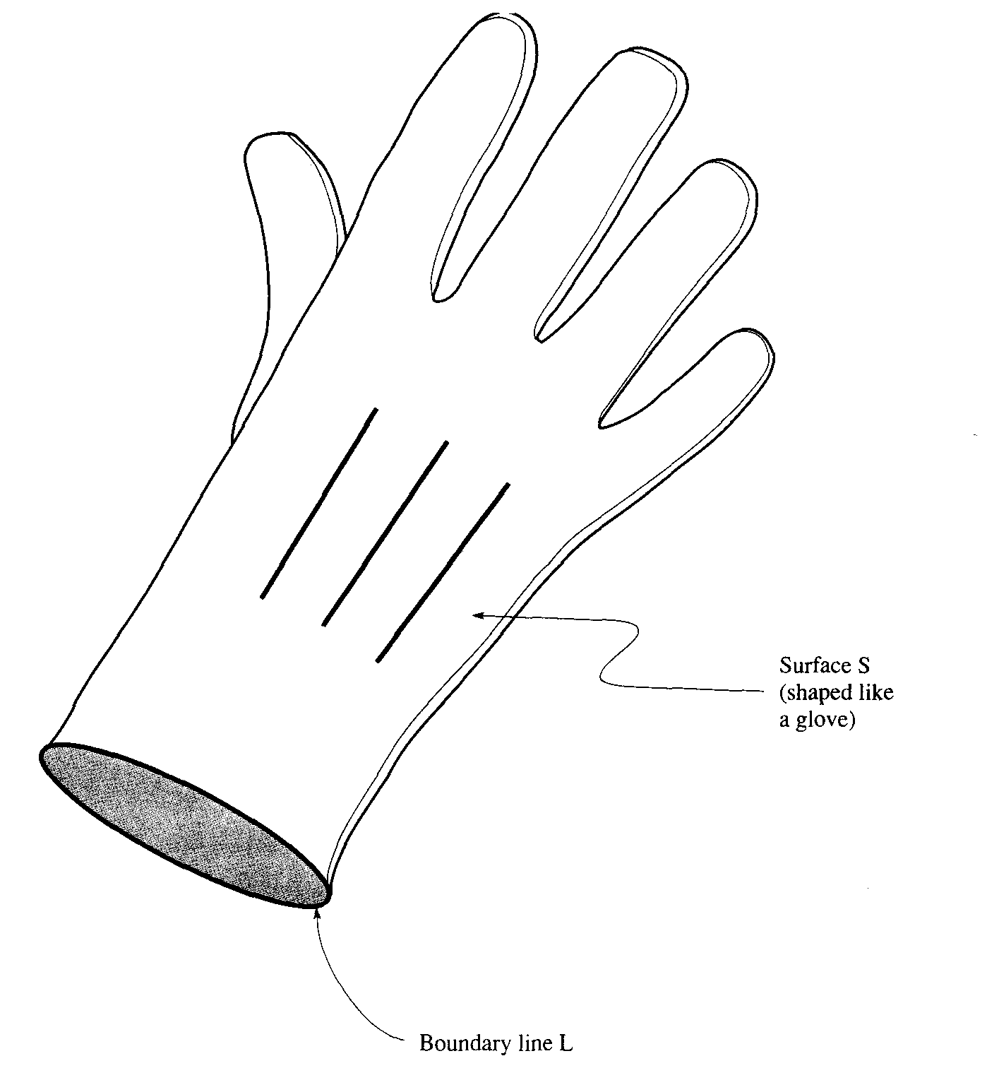
Magnetostatics
Total magnetic flux through surface S:
ψ
Stoke’s theorem
Surface S1 (shaped like a glove)
The total magnetic flux
through S₁ and S₂ (both
bounded by L) is the
same and equal to the
circulation of over L.
Surface S2 (circular)
Boundary line L (same for both S1 and S2)

Slide 31
Three approaches to finding magnetic fields from known sources (steady currents)
Biot – Savart’s Law
Ampere’s Law
From magnetic vector potential:

Slide 32
Magnetostatics
The Magnetostatic Curl Equation
Basic equation of magnetostatics, that allows one to find the current when the magnetic field is known is:
where is the magnetic field intensity, and is the current density (current per unit area passing through a plane perpendicular to the flow).
The magnetostatic curl equation is analogous to the electrostatic field source equation:

Slide 33
Magnetostatics
Ampere’s Law
Choosing any surface S bounded by the border line L and
applying Stokes’ theorem to the magnetic field intensity
vector , we have
Substituting the magnetostatic curl equation:
we obtain
which is the Ampere’s Law. It states that the circulation
of around a closed path (contour) is equal to the current enclosed by that path.

Slide 34
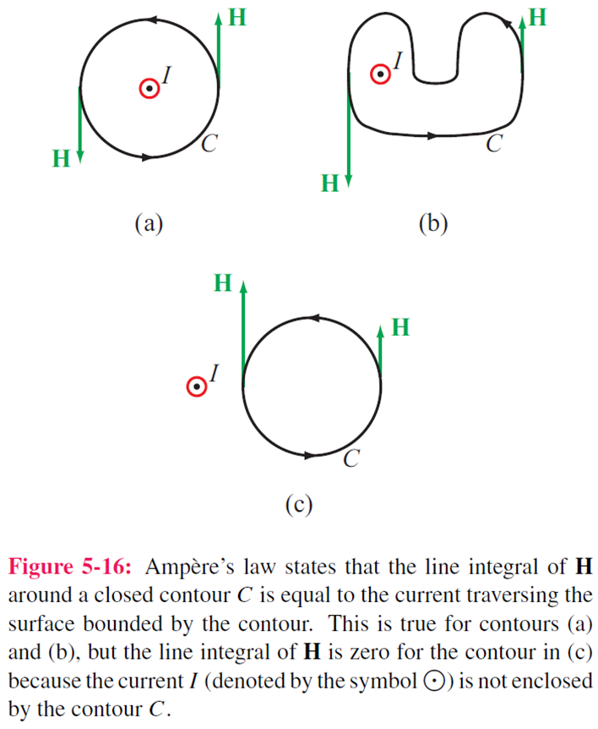

Slide 35
READING ASSIGNMENT FOR SECTION 4 (Magnetostatics) Textbook (Ulaby and Ravaioli): In Ch. 5, Sections 5.1-5.4, 5.6, Chapter 5 Summary (pp. 272-273) Examples: 5-1 to 5-6 Exercises: 5-1 to 5-10 and 5-12 Course Packet (Lecture Slides, http://www.rakov.ece.ufl.edu/teaching/3472.html): Magnetostatics HA4 (take-home Test 4) will be given on Nov. 2 (M) between 1 and 2 p.m.; HW4 is to be turned in via Canvas not later than Nov. 4 (W), 11:45 a.m.

Slide 36
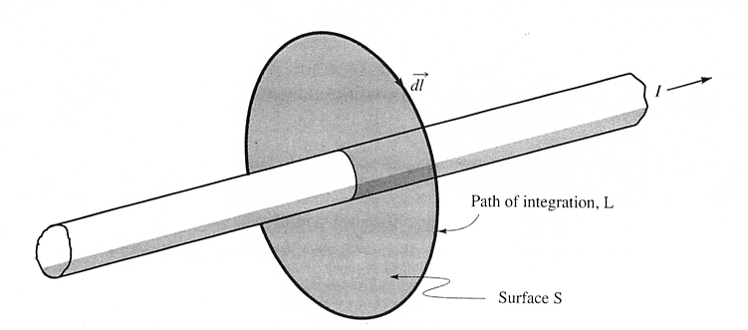
Magnetostatics
R
(Amperian Path)
Ampere’s law is very useful in determining when there is a closed path L around the current I such that the magnitude of is constant over the path.

Slide 37
Electric & Magnetic Forces
Positive charge
Magnetic force
Negative charge
Electromagnetic (Lorentz) force
Positive charge

Slide 38
Magnetostatics
Magnetic Force
One can tell if a magnetostatic field is present because it
exerts forces on moving charges and on currents. If a current
element is located in a magnetic field , it experiences a
force
This force, acting on current element , is in a direction
perpendicular to the current element and also perpendicular
to . It is largest when and the wire are perpendicular.

Slide 39
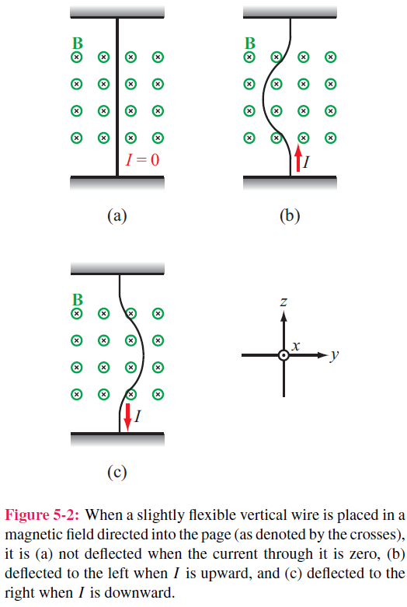
dF ←
→ dF

Slide 40
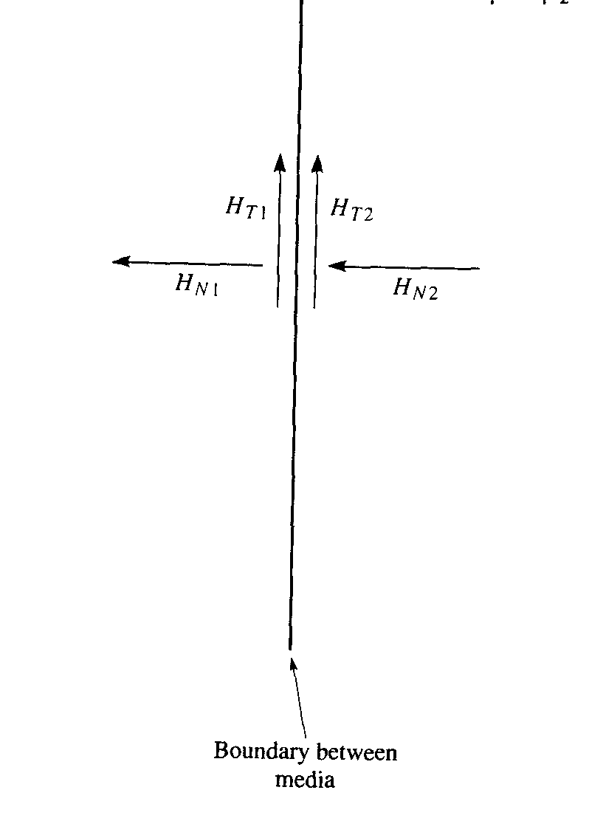
Magnetic field boundary conditions
Magnetostatics
Boundary conditions are the relations between field components in two different media at the boundary between those two media.
T= tangential components
N= normal components
We will make use of Gauss’ law for magnetic fields for and
and Ampere’s law for and
Magnetic field lines form closed loops

Slide 41
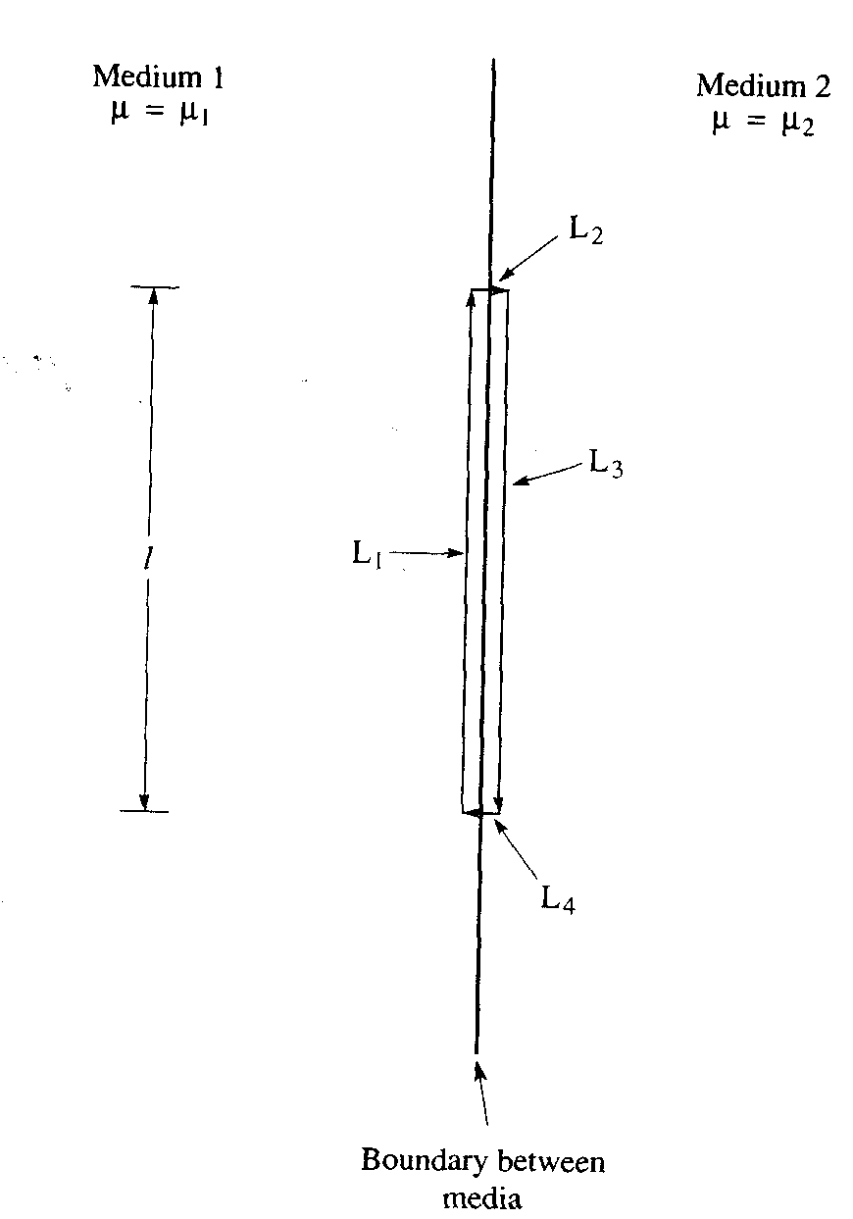
Magnetostatics
Boundary condition on the tangential component of
In the limit as
we have
where is the current on the boundary surface
(since the integration path in the limit is infinitely narrow).
When the conductivities of both media are finite,
The tangential component of is continuous across the boundary, while that of is discontinuous
Amperian path ↗ (rectangular)
and hence

Slide 42
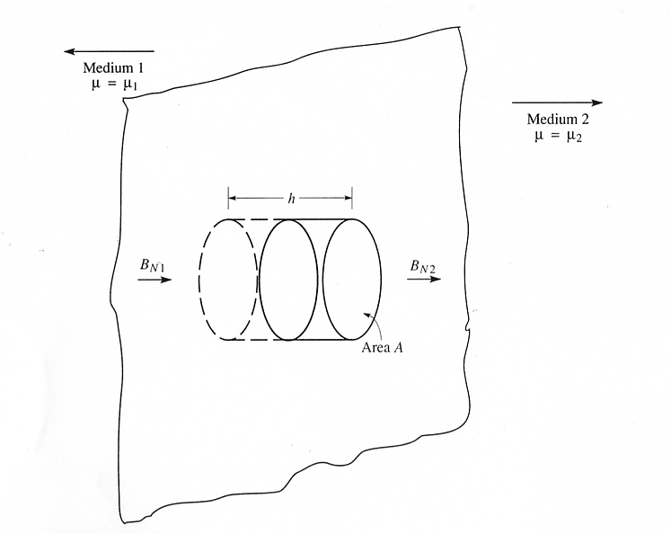
Magnetostatics
Boundary condition on the normal component of B
Gaussian surface S (cylinder with its plane faces parallel to the boundary)

Slide 43
Magnetostatics
Boundary condition on the normal component of B
Integral of over any closed surface S is equal to zero:
In the limit as , the surface integral over the curved
surface of the cylinder vanishes. Thus we have
S
(the normal component of is continuous at the boundary)
(the normal component of is discontinuous at the boundary)

Slide 44
Electric vs Magnetic Comparison
Field lines form closed loops
G.L.
Conservative →
← A.L.

Slide 46
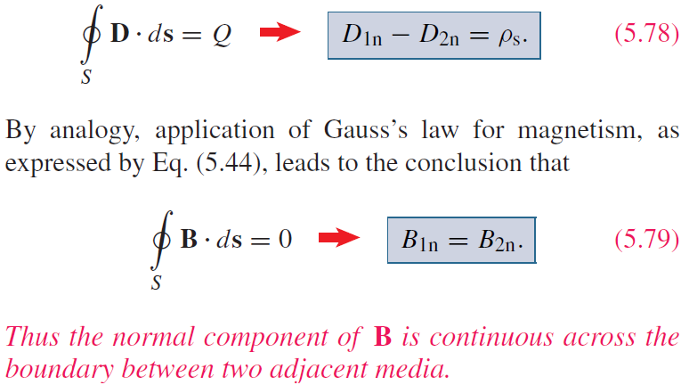
Boundary Conditions

Slide 47
Ampère’s Law

Slide 48
Magnetic Force on a Current Element
Differential force dFm on a differential current I dl:

Slide 49
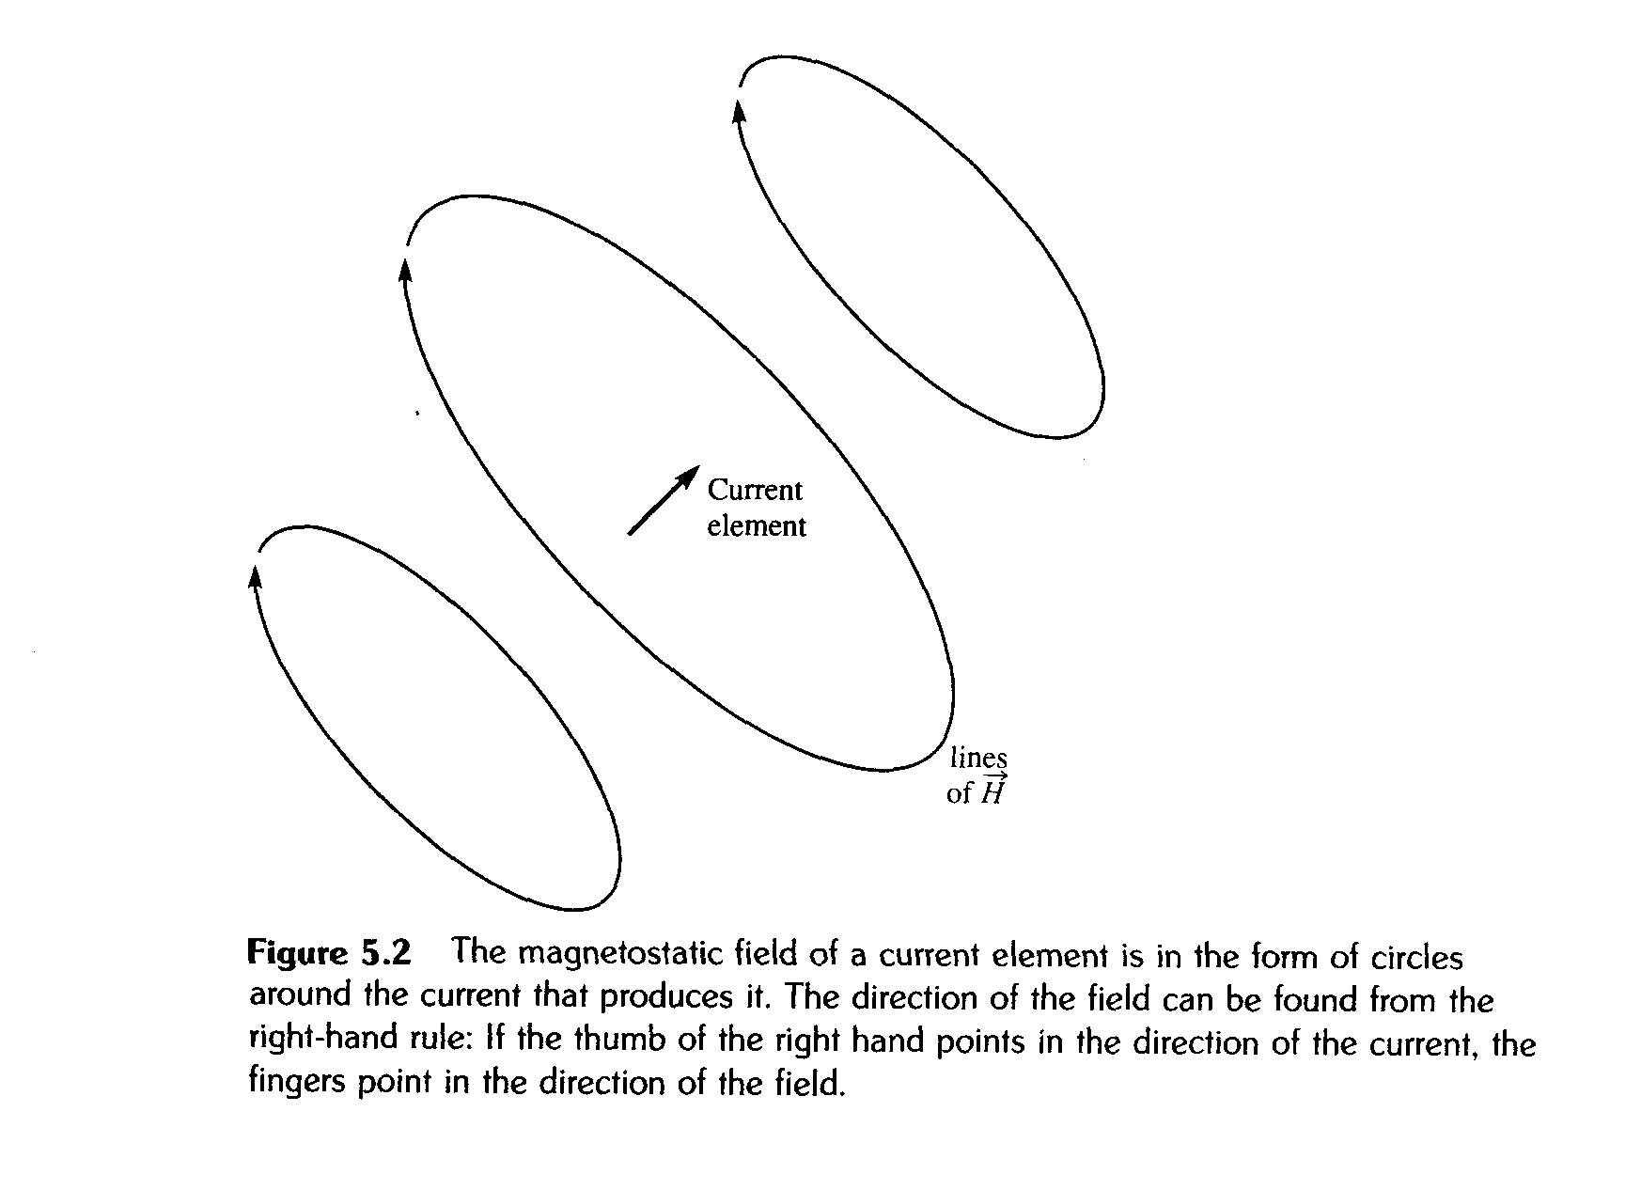
Magnetostatics
The field produced by a wire can be found adding up the fields produced by a large number of current elements placed head to tail along the wire (the principle of superposition).

