Slide 1
Electrostatics

Slide 2
Time Table, updated on 09/21/20
Course Section | Number of Lectures | HA Given | HW Due | Chapter(s) in Text (Ulaby)
Introduction | 1 | - | - | 1
Transmission Lines (TEM field waves can be represented by V and I (scalars) waves) | 7 | 09/21 | 09/23 | 2
2. Review of Vector Analysis | 5 | 10/05 | 10/07 | 3
3. Electrostatics | 7 | 10/19 | 10/21 | 4
4. Magnetostatics | 5 | 11/02 | 11/04 | 5
5. Time-Varying Fields | 8 | 11/20 | 11/23 | 6, 5.7, 7.5
6. Electromagnetic Waves | 6 | 12/07 | 12/09 | 7, 8
Review | 1 | - | - | 1-8
Final Exam (format to be announced later) Group 18C | - | - | 12/18 (12:30-2:30 p.m.) | 1-8

Slide 3
READING ASSIGNMENT FOR SECTION 3 (Electrostatics) Textbook (Ulaby and Ravaioli): In Ch. 4, Sections 4.2-4.6, 4.9-4.11, Chapter 4 Summary (pp. 225-226) Examples: 4-1 to 4-9 and 4-11 to 4-13 Exercises: 4-1 to 4-15, 4-18, and 4-19 Course Packet (Lecture Slides, http://www.rakov.ece.ufl.edu/teaching/3472.html): Electrostatics HA3 (take-home Test 3) will be given on Oct. 19 (M) between 1 and 2 p.m.; HW3 is to be turned in via Canvas not later than Oct. 21 (W), 11:45 a.m.

Slide 4
Three approaches to finding electric fields from known sources (discrete or continuous charge distributions)
Coulomb’s Law
Gauss’ Law
From electric potential:

Slide 5
Electrostatics
Electrostatics
An electrostatic field is produced by a static (or time-invariant) charge distribution. A field produced by a thunderstorm cloud can be viewed as an electrostatic field.
Coulomb’s law deals with the force a point charge exerts on another point charge. The force F between two charges Q₁ and Q₂ is
1. Along the line joining Q₁ and Q₂
2. Directly proportional to the product Q₁ x Q₂ of the charges
3. Inversely proportional to the square of the distance r
between the charges

Slide 6
Electrostatics
In the international system of units (SI), Q and Q are in coulombs (1C is approximately equivalent to electrons since one electron charge e = C), the distance r is in meters, and the force F is in Newtons so that:
1
2
F/m
the permittivity
of free space
or
m/F

Slide 7
Electrostatics
Electric field intensity (or electric field strength) is defined as the Coulomb force per unit charge that a very small stationary test charge (positive) experiences when it is placed in the electric field:
,
In practice, the test charge should be small enough not to disturb the field distribution of the source.
For a single point charge Q located at the origin:
where is a unit vector pointing in the radial direction (away from the charge).
is valid for vacuum and air. For other materials should be replaced by
(typically ).

Slide 8
Electrostatics
Suppose that there are several charges located at positions with respect to the origin. The observation point is at position . The vector distance from the ith charge to the observation point is ( ), and the distance is .
Source point
The total field due to N charges is
Observation
(field) point

Slide 9
Electrostatics
Example: Find the electric field at P due to +Q and –Q.
The vector from Q to P lies
in the x-y plane.
Therefore, (the z component
of ) vanishes at P.
y components due to Q and –Q
are equal and opposite and
therefore add to zero.
d
b
b
cosθ=-cos(180º-θ)=-b/(b²+d²)^{1/2}
Thus, has only an x component:

Slide 10
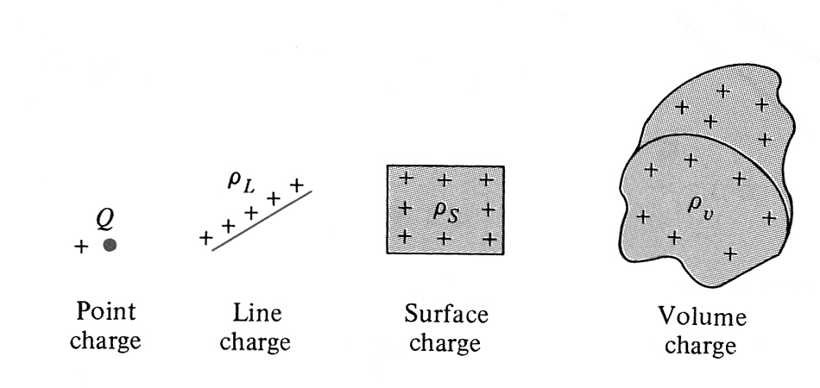
Electrostatics
Charge density
Various charge distributions.
Consider a charged wire. Charge on an elemental wire segment is so that the charge per unit length . The total electric field is the sum of the field contributions from the individual segments.
If we let we get
Position of the field point
Position of the source point
Line integral

Slide 11
Electrostatics
If the charge is distributed on a surface (surface charge density ), we can write
Unit vector directed from the source point to the field point
Surface integral
If charge is distributed through a volume ,
Volume integral

Slide 12
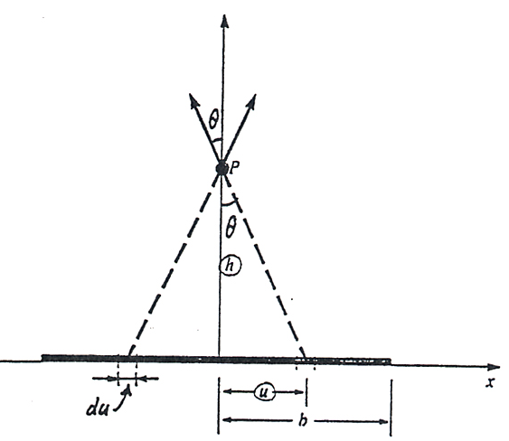
Electrostatics
Example: A circular disk of radius b with uniform surface charge density , lies in the x-y plane with its center at the origin. Find the electric field at P (z=h).
All the contributions in the x and y directions are cancelled, and the field at P contains only z component.
dS=ududϕ
Integral over ϕ from 0 to 2ϖ is equal to 2ϖ.

Slide 13
Electrostatics
The Source Equation (applies to a single point in space)
As we have seen, the electric field can be expressed as an integral of the charges that produce it:
E is the integral of ρ
over volume V’
V’
V’
Therefore, the charge can be expressed in terms of spatial derivatives of the electric field (one can solve the above equation for ρ/ε as V’ 0). In rectangular coordinate system:
ρ/ε
The right-hand side is the divergence of E ( ) ; so the divergence of εE is equal to ρ.
Source equation
The divergence of a vector field at a given point is a measure of how much the field diverges or emanates from that point.

Slide 14
Electrostatics
The Source Equation (continued)
Example: Let be the field of a single point charge Q at the origin. Show that
is zero everywhere except at the origin.
where
The x-component of is
The divergence of a vector field at a given point is a measure of how much the field diverges or emanates from that point.
everywhere, except at the origin (x=0, y=0, z=0) where the source and field points coincide and derivatives are undefined.

Slide 15
Electrostatics
The Source Equation (continued)
In cylindrical coordinates
In spherical coordinates
Example: Let be the electrostatic field of a point charge Q at the origin. Express this field in spherical coordinates and find its divergence.
everywhere except at the origin, where is undefined (because the source point and field point coincide).

Slide 16
Electrostatics
Gauss’ Law
For an arbitrary vector A, according to the divergence theorem:
We now apply the divergence theorem to the source equation integrated over volume V:
Gauss’ Law
Gaussian surface (closed)
Total enclosed charge

Slide 17
Electrostatics
Gauss’ Law
Essentially, it states that the net electric flux through any closed surface is equal to the total (net) charge enclosed by that surface. Gauss’ law provides an easy means of finding the electric field for symmetrical charge distributions such as a point charge, an infinite line charge, and infinite cylindrical surface charge, and a spherical distribution of charge.
where S is an arbitrary closed surface and V is the volume enclosed by S. The left-hand side is the total (net) outward electric field flux through S and the right-hand side is the total (net) charge enclosed by S.

Slide 18
Gauss’ Law
The angle between and the outward normal to the surface
- the normal component of
Gaussian
Surface (GS)
If E_{n} = const everywhere on GS, then E_{n} = Q_{encl}/(εA_{GS})

Slide 19
Three approaches to finding electric fields from known sources (discrete or continuous charge distributions)
Coulomb’s Law
Gauss’ Law
From electric potential:

Slide 20
Electrostatics
Gauss’ Law (continued)
Example: Find the electric field at a distance r from a point charge q using Gauss’ law.
Let the surface S (Gaussian surface) be a sphere of radius r centered on the charge. Then the angle between and the outward normal to the surface and . Also, (only radial component is present).
$$ψ=0^{o}$$
$$cosψ=1{}$$
E_{r}
Since E_{r} = const everywhere on the Gaussian surface, we can write

Slide 21
Electrostatics
Gauss’ Law (continued)
Example: A uniformly charged sphere with volume charge density and radius b is centered at the origin. Find the electric field at a distance r from the origin for r ≥ b and r ≤ b.
As in previous example, the electric field is radial and spherically symmetric.
(1) r ≥ b
decreases as 1/r²
(2) r ≤ b
(just replace b³ with r³, since there is no enclosed charge between r and b)
When r = b,
increases linearly with r
Gauss’ law can be used for finding when is constant on the Gaussian surface, so that Ecosθ = E and can be taken out of the integral.

Slide 22
Electrostatics
Gauss’ Law (continued)
Example: Determine the electric field intensity of an infinite planar charge with a uniform, positive surface charge density .
e_{z}
coincides with the x-y plane
-e_{z}
The field due to a charged sheet of an infinite extent is normal to the sheet; that is, has only z-directed component when the sheet is in the x-y plane.
We choose as the Gaussian surface a rectangular box with top and bottom faces of an arbitrary area A, equidistant from the planar charge (the distance is also arbitrary). The sides of the box are perpendicular to the charged sheet.

Slide 23
Electrostatics
Gauss’ Law (continued)
On the top face:
On the bottom face:
There is no contribution from the side faces. Thus,
The total enclosed charge is
(independent of z)

Slide 24
Corona discharge from barbed wire
Barbed wire subjected to a positive dc voltage of 400-kV magnitude in laboratory. Adapted from Gary (1994).

Slide 25
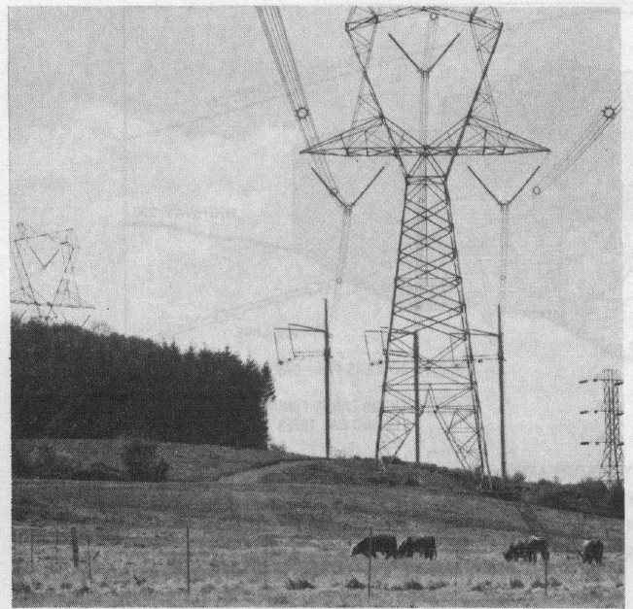
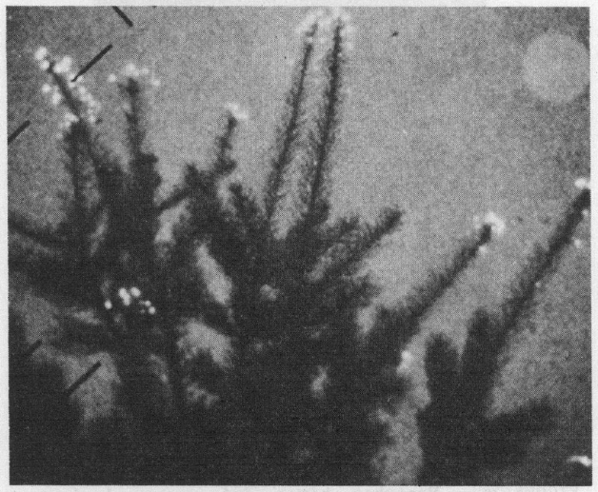
Corona discharge from trees
Phase conductor
(8-conductor bundle) of a 1.2-MV transmission line
(Left) 1200-kV ac transmission line in Lyons, Oregon. Douglas fir trees at the edge of the line right-of-way are seen on the left side of the picture. Typical measured ground-level electric field maxima were 7 to 9 kV/m. (Right) Corona on a Douglas fir tree located about 12 m from conductors of the line. Photograph was taken with a night viewing device. Needle tip burns were observed. Adapted from Rogers et al. (1979).

Slide 26
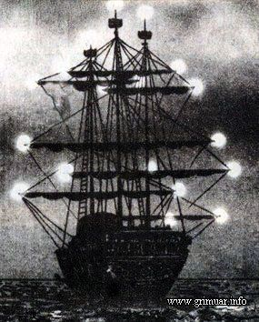
St. Elmo’s fire (corona) on a ship

Slide 27
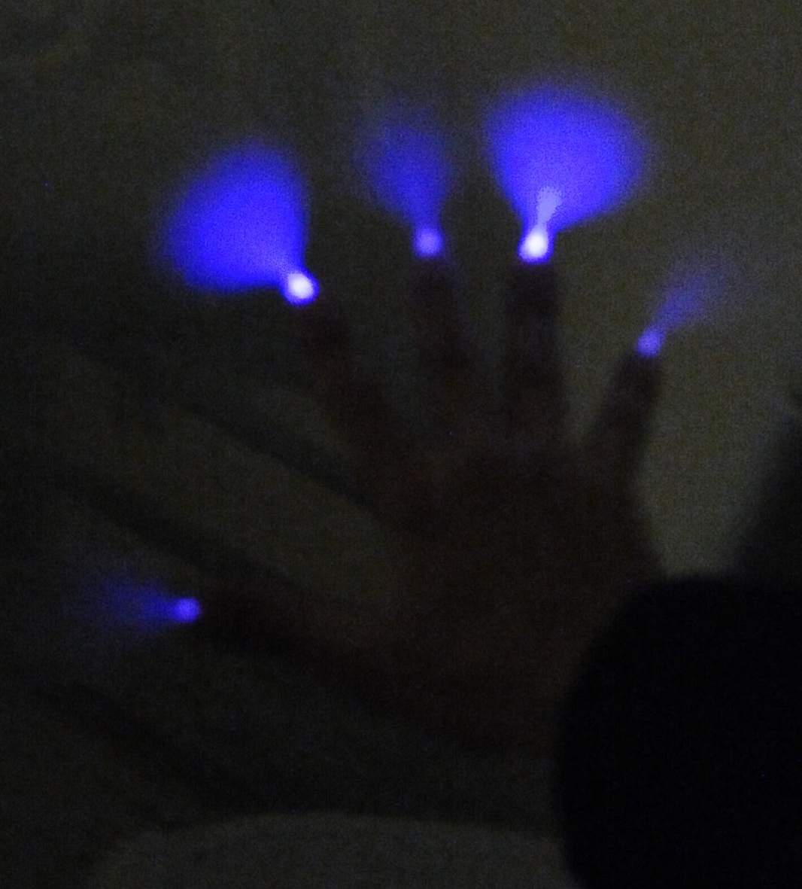
Corona from a human hand
Corona discharge from a human hand in laboratory (Istra, Russia). Electric field was produced by a cloud of negatively-charged water droplets. The hand was at a distance of 3 to 5 m from the cloud edge. Courtesy of Dr. A. Kostinskiy.

Slide 28
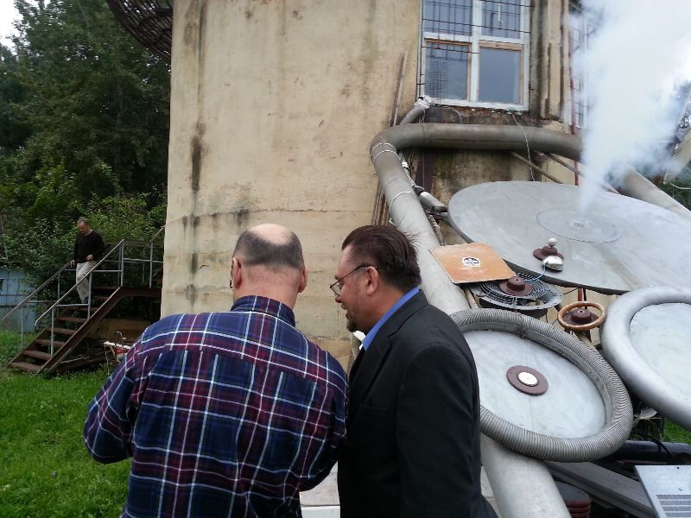
Cloud of charged
water droplets

Slide 29
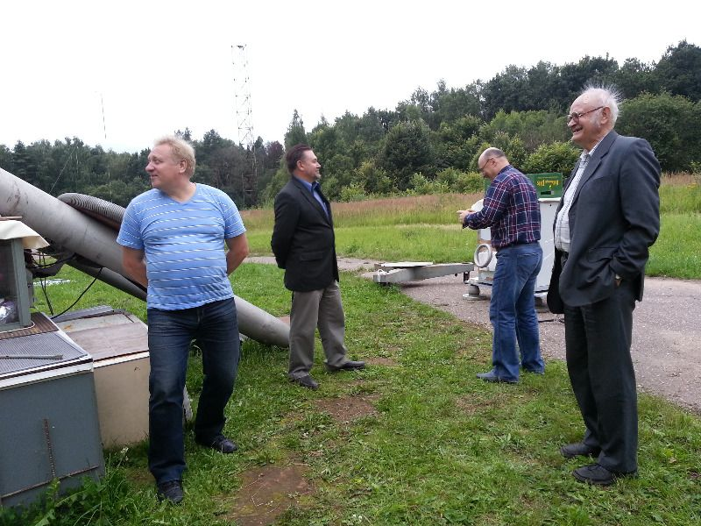
Cloud of charged
water droplets
↙

Slide 30
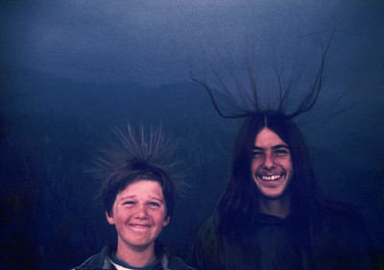
Overhead thundercloud

Slide 31
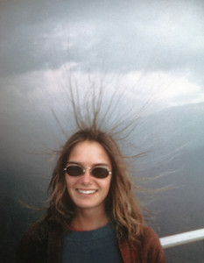
Overhead thundercloud
Safety Tip

Slide 32
Electrostatics
Ohm’s Law
Ohm’s law used in circuit theory, V=IR, is called the “macroscopic” form of Ohm’s law. Here we consider “microcopic” (or point form). (Applicable to conduction current only). Let us define the current density vector . Its direction is the direction in which, on the average, charge is moving. is current per unit area perpendicular to the direction of . The total current through a surface is
(if , , ,
According to Ohm’s law, current density has the same direction as electric field, and its magnitude is proportional to that of the electric field:
where is the electric conductivity. The unit for is siemens per meter
( ).
Copper S/m
Seawater 4 S/m
Ground 10⁻³ S/m
Glass 10⁻¹² S/m

Slide 33
Electrostatics
Ohm’s Law (continued)
The reciprocal of is called resistivity, in ohm-meters ( ).
Suppose voltage V is applied to a conductor of length l and cross-sectional area S.
Within the conducting material
( constant)
“macroscopic” form of Ohm’s law
Resistance of the conductor

Slide 34
Electrostatics
Electrostatic Energy and Potential
A point charge q placed in an electric field experiences a force:
If a particle with charge q moves through an electric field from point P1 to point P2, the work done on the particle by the electric field is
This work represents the difference in electric potential energy of charge q between point P1 and point P2
(W is negative if the work is done by an external agent)
W = W - W
1
2
The electric potential energy per unit charge is defined as electric potential V (J/C or volts)
V₂ = V₁ if dl is perpendicular to E (equipotential path), and the difference in V is maximum when they are collinear.
Electrostatic potential difference or voltage between P and P (independent of the path between P and P )
1
2
1
2

Slide 35
Electrostatics
Electrostatic Energy and Potential (continued)
V1 and V2 are the potentials (or absolute potentials) at P1 and P2, respectively, defined as the potential difference between each point and chosen point at which the potential is zero (similar to measuring altitude with respect to sea level). In most cases the zero–potential point is taken at infinity.
Example: A point charge q is located at the origin.
Find the potential difference between P1 (a,0,0) and P2 (0,b,0)
due to q is radial. Let us choose a path of integration composed of two segments. Segment I (circular line with radius a) and Segment II (vertical straight line).

Slide 36
Electrostatics
Electrostatic Energy and Potential (continued)
Example (continued):
Segment I contributes nothing to the integral because is perpendicular to everywhere along it. As a result, the potential is constant everywhere on Segment I; it is said to be equipotential. (Electric field lines are always perpendicular to equipotentials)
On Segment II, , , and
If we move P2 to infinity (b = ∞) and set V2=0,
where a is the distance between the observation point and the source
point
for line charge
In general,
for surface charge
for volume charge

Slide 37
Electrostatics
Gradient of a Scalar Field
The gradient operator is a differential operator. It acts on the potential (a scalar) to produce the negative of electric field (a vector).
The gradient of V is a vector which points in the direction of the maximum rate of increase of V, which is opposite to the direction of electric field.
Let us consider two points and which are quite close together.
If we move from P1 to P2 the potential will change from V to where
1
due to the change in z
Potential change
(scalar)
ΔV = V₂ – V₁
The displacement vector (expresses the change in position as we move from P1 and P2) is
vector
Gradient operator

Slide 38
Electrostatics
Gradient of a Scalar Field (continued)
The relation between and can be expressed using the gradient of V:
vector
ΔV = V₂ – V₁
On the other hand, if we let P1 and P2 to be so close together that is nearly constant,
➔
The negative sign shows that the direction of is opposite to the direction in which V increases.

Slide 39
Three approaches to finding electric fields from known sources (discrete or continuous charge distributions)
Coulomb’s Law
Gauss’ Law
From electric potential:

Slide 40
Electrostatics
Gradient of a Scalar Field (continued)
Example: Determine the electric field of a point charge q located at the origin, by first finding its electric scalar potential.

Slide 41
Electrostatics
Gradient of a Scalar Field (continued)
The electric field is directed from the conductor at higher potential to the one at lower potential. Since , the electric field is always perpendicular to the equipotentials.
If we assume that for an ideal metal , no electric field can exist inside the metal (otherwise , which is impossible).
Considering two points P1 and P2 located inside a metal or on its surface and recalling that we find that V1=V2. This means the entire metal
is at the same potential, and its surface is equipotential. So, electric field lines are always perpendicular to metallic surfaces (tangential component of electric field is equal to zero)

Slide 42
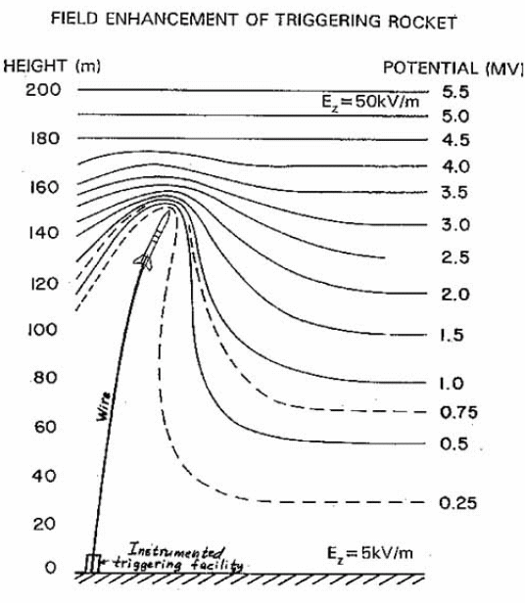
The rocket-and-wire technique for triggering lightning
E_{z} = -ΔV/Δz
Schematic illustration of the
equipotential surfaces in the lowest 200 m and their interaction with a rocket extending grounded wire in the thundercloud electric field.
The equipotentials are closely spaced aloft where the vertical field is assumed to be 50 kV/m, and near the tip of the rocket, where they are concentrated geometrically.
They are further apart near the ground, where the field is greatly reduced by corona space charge.
wire
Instrumented
triggering facility
42
42

Slide 43
F0321-OFFICE-WIDE
43

Slide 44
3. ELECTROSTATICS - 7 lectures
- Coulomb's law and electric field intensity
- The source equation; divergence
- Gauss' law
- Ohm's law
- Electrostatic energy and potential; gradient
- Capacitors
- Boundary condition on the normal electric field
- Laplace's and Poisson's equations; Laplacian
- Method of images

Slide 45
Electrostatics
Capacitors
Any two conductors carrying equal but opposite charges form a capacitor. The capacitance of a capacitor depends on its geometry and on the permittivity of the dielectric separating the conductors.
The capacitance C of a capacitor is defined as the ratio of the magnitude of Q of the charge on one of the plates and the potential difference V between them.
Gaussian
surface
Area A
d
d is very small compared with the lateral dimensions of the capacitor (fringing of at the edges of the plates is neglected). Then V = E x d.
A parallel-plate capacitor.
Cylindrical
Gaussian
Surface
Top face (inside the metal)
Side surface
Boundary
condition on of D_{n} (D_{t}=0)
Bottom face
Close-up view of the upper plate of the capacitor.

Slide 46
G.S.
$$d\overline{S}$$
$$∆A$$
$$Q_{encl}=σ∆A$$
$$Ψ_{out}=\oint_{S}^{ }{ε\overline{E}∙d\overline{S}=Ψ_{top}+Ψ_{bot}+Ψ_{lat}=Q_{encl}=σ∆A}$$
2 Metal
$$(\overline{E}=0)$$
v
Boundary
$$ε\left|\overline{E}\right|∆A$$
1 Dielectric
$$\left|\overline{E}\right|=\frac{σ}{ε}$$
$$d\overline{S}$$
$$\left|\overline{E}\right|∙ε=σ$$
$$\left|\overline{D}\right|=σ$$
$$\overline{E}$$
$$d\overline{S}$$
$$D_{n1}=σ (Diel./Cond\text{.})$$
In general, $D_{n1}−D_{n2}=σ$
$$V=\left|\overline{E}\right|∙d$$
$D_{n1}=D_{n2}$ (Diel./Diel.)
$$C=\frac{Q}{V}=\frac{σA}{\left|\overline{E}\right|∙d}=\frac{σA}{\frac{σd}{ε}}=\frac{εA}{d}$$

Slide 47
Review of Vector Analysis
Differential Operators
1. - gradient, acts on a scalar to produce a vector
2. - divergence, acts on a vector to produce a scalar
3. - curl, acts on a vector to produce a vector
4. - Laplacian, acts on a scalar to produce a scalar

Slide 48
Electrostatics
Laplace’s and Poisson’s Equations
The usual approach to electrostatic problems is to begin with calculating the potential. When the potential has been found, it is easy to find the field at any point by taking the gradient of the potential:
the divergence
operator
the source equation
vector
the gradient
operator
the Laplacian
operator
Poisson’s equation
If no charge is present ,
Laplace’s equation

Slide 49
Electrostatics
Laplace’s and Poisson’s Equations (continued)
The form of the Laplacian operator can be found by combining the gradient and divergence operators.
In rectangular coordinates:
- in cylindrical coordinates
in spherical
coordinates
Electrostatic problems where only charge and potential at some boundaries are known and it is desired to find and V throughout the region are called boundary-value problems (e.g., E-field distribution inside electrical apparatus). They can be solved using experimental, analytical, or numerical methods.

Slide 50
Electrostatics
Method of Images
A given charge configuration above an infinite grounded perfectly conducting plane may be replaced by the charge configuration itself, its image, and an equipotential surface in place of the conducting plane. The method can be used to determine the fields only in the region where the image charges are not located.
Original problem
Configuration for solving original problem by the method of images. Field lines above the z=0 plane are the same in both cases.
By symmetry, the potential in this plane is zero, which satisfies the boundary conditions of the original problem.

Slide 51
$$+q$$
$$+q$$
$$+q$$
$$+τ$$
$$+ρ$$
$$h$$
$$V=0$$
$$−$$
$$−$$
$$−$$
$$−$$
$$V=0$$
$$\overline{E}=0$$
$$h$$
$$−τ$$
$$−ρ$$
$$−q$$

Slide 52
$$\overline{E}={\overline{E}}_{+}^{ }+{\overline{E}}_{−}^{ }=\frac{q{\overline{r}}_{+}}{4πεr_{+}^{3}}+\frac{−q{\overline{r}}_{−}}{4πεr_{−}^{3}}$$
$${\overline{r}}_{+}^{ }=(x,y,z−h)$$
Vector distances
$${\overline{e}}_{z}^{ }$$
$${\overline{r}}_{+}^{ }$$
$$P(x,y,z)$$
$${\overline{r}}_{−}^{ }=(x,y,z+h)$$
$$(\overline{r}−r^{′})$$
$${\overline{r}}_{+}^{′}=(0,0,h)$$
$$(x,y,z)$$
$$+q$$
$${\overline{r}}_{−}^{ }$$
$$\overline{E}=\frac{q}{4πε}=\left\{\frac{x{\overline{e}}_{x}+y{\overline{e}}_{y}+(z−h){\overline{e}}_{z}}{{\left[x^{2}+y^{2}+{(z−h)}^{2}\right]}^{3/2}}−\frac{x{\overline{e}}_{x}+y{\overline{e}}_{y}+(z+h){\overline{e}}_{z}}{{\left[x^{2}+y^{2}+{(z+h)}^{2}\right]}^{3/2}}\right\}$$
$$V=0$$
$$(0,0,0)$$
x-y
plane
$$If x=0, y=0, z=0,$$
$$\overline{E}=−\frac{q}{2πεh^{2}}{\overline{e}}_{z}$$
$$−q$$
$${\overline{r}}_{−}^{′}=(0,0,−h)$$
$$V=V_{+}{+V}_{−}=\frac{q}{4πεr_{+}}+\frac{−q}{4πεr_{−}}=\frac{q}{4πε}\left\{\frac{1}{{\left[x^{2}+y^{2}+{(z−h)}^{2}\right]}^{1/2}}−\frac{1}{{\left[x^{2}+y^{2}+{(z+h)}^{2}\right]}^{1/2}}\right\}$$
$$\overline{E}=−∇V$$
$$If z=0,$$
$$V=0 for any x and y$$

Slide 53
$$+q$$
$$∅$$
$$Number of image charges:$$
1
$$N=\frac{{360}^{°}}{∅}−1$$
$$Step 1$$
Remove vertical plane
$$−q$$
$$+q$$
$∅=$ ${180}^{°}$
$$N=1$$
$∅=$ ${90}^{°}$
$$N=3$$
$$Step 2$$
Remove horizontal plane
2
$$−q$$
$$+q$$
$$+q$$
$$−q$$

