Slide 1
Electromagnetic
Waves

Slide 2
READING ASSIGNMENT FOR SECTION 6 (Electromagnetic Waves) Textbook (Ulaby and Ravaioli): In Ch. 7, Sections 7.1, 7.2, 7.3 (may skip subsection 7.3.3), 7.4, 7.6, Chapter 7 Summary (pp. 346-347); in Ch. 8, Section 8.1 (including Examples and Exercises in each Section). Course Packet (Lecture Slides, http://www.rakov.ece.ufl.edu/teaching/3472.html): Electromagnetic Waves HA6 (take-home Test 6) will be given on Dec. 7 (M) between 1 and 2 p.m.; HW6 is to be turned in via Canvas not later than Dec. 9 (W), 11:45 a.m.

Slide 3
Electromagnetic Waves
Spherical wavefront at
different instants of time
Direction of propagation
(perpendicular to the wavefront)
Plane-wave approximation

Slide 4
Electromagnetic Waves
Electromagnetic Waves
In the case of (fields inside a good insulator such
as air or vacuum) we have
vector Helmholtz
equation
This equation has a rich variety of solutions.
Let us assume that has only an x component and varies
only in the z direction. In this case the vector Helmholtz
equation simplifies to
scalar Helmholtz
equation
The latter equation is similar to the voltage wave equation
for a lossless transmission line.
Wave equation (describes all known effects of moving charges)
γ² =-ω²με
γ =jω(με)^{1/2} prop. const.

Slide 5
Electromagnetic Waves
The solution of the scalar Helmholtz equation is
where , to be found from boundary conditions;
the minus and the plus correspond to waves moving in the
+z and –z directions, respectively.
In terms of propagation constant k
The position of a field maximum is given by
k (same as β)

Slide 6
Electromagnetic Waves
Characteristics of Plane Waves
For a plane wave which propagates in the +z direction and
has an electric field pointing in the x direction
where
The time-varying electric field of the wave must, according
to Faraday’s law, be accompanied by a magnetic field.
Thus,
when and is called the characteristic impedance of vacuum.
← phase constant
Wave impedance (intrinsic impedance of the medium)

Slide 7
Electromagnetic Waves
If
, , and the direction of propagation
are all perpendicular to each other.
2. and are in phase.
3. The wave appears to move in the +z direction as though it were a rigid structure moving toward the right
(in exactly the same way as the transmission-line waves).

Slide 8
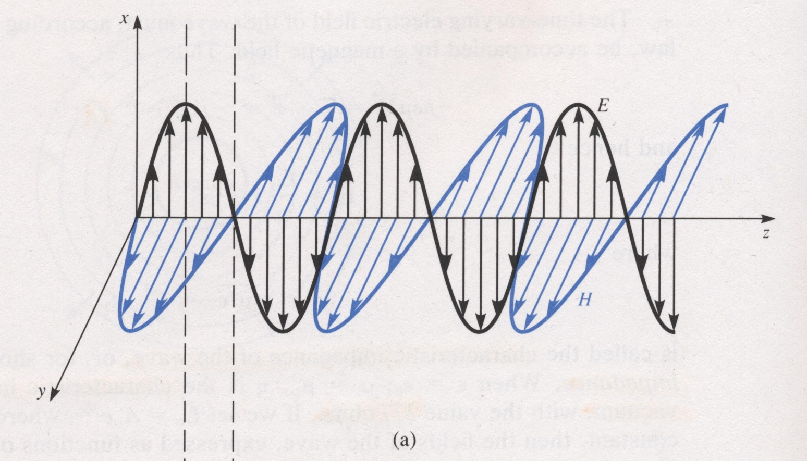
Electromagnetic Waves
In general,
← unit vector showing the direction
of propagation
E
In the x-z plane
e_{k}
H
λ/4
In the y-z plane
8

Slide 9
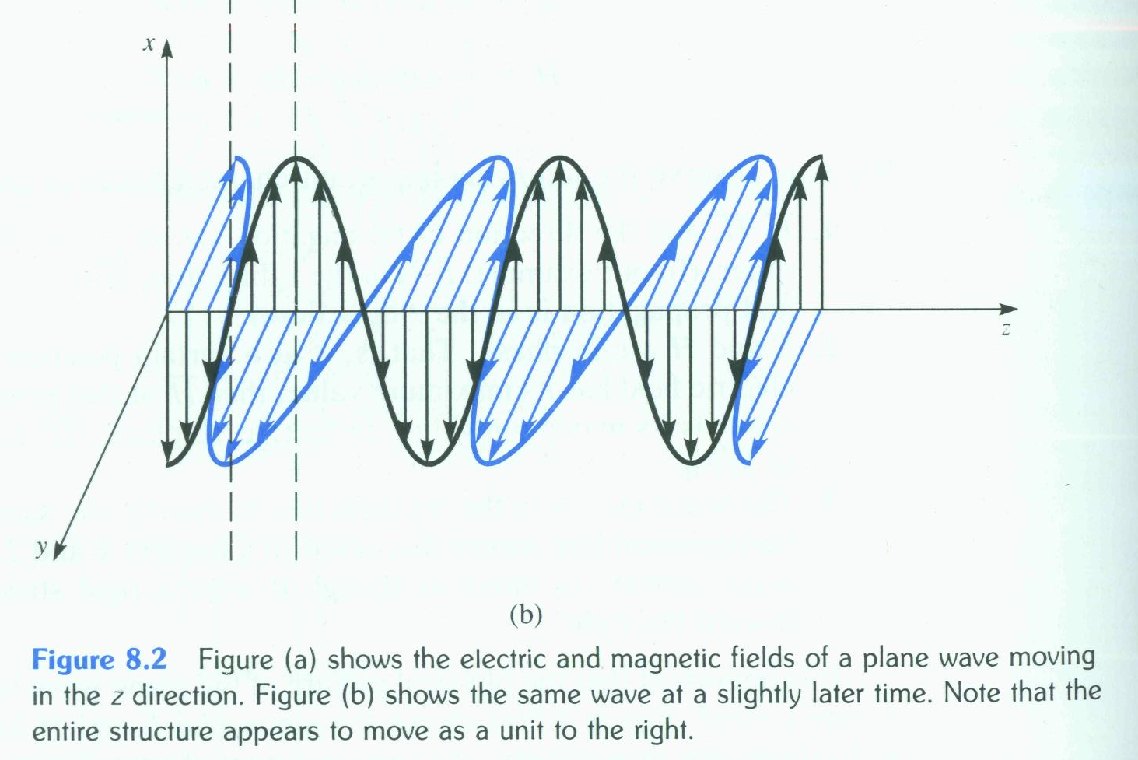
Electromagnetic Waves
When the electric field of a wave is always directed along
the same line, the wave is said to be linearly polarized.
Linear polarization
λ/4
9

Slide 10
Electromagnetic Waves
Circular polarization
10

Slide 11
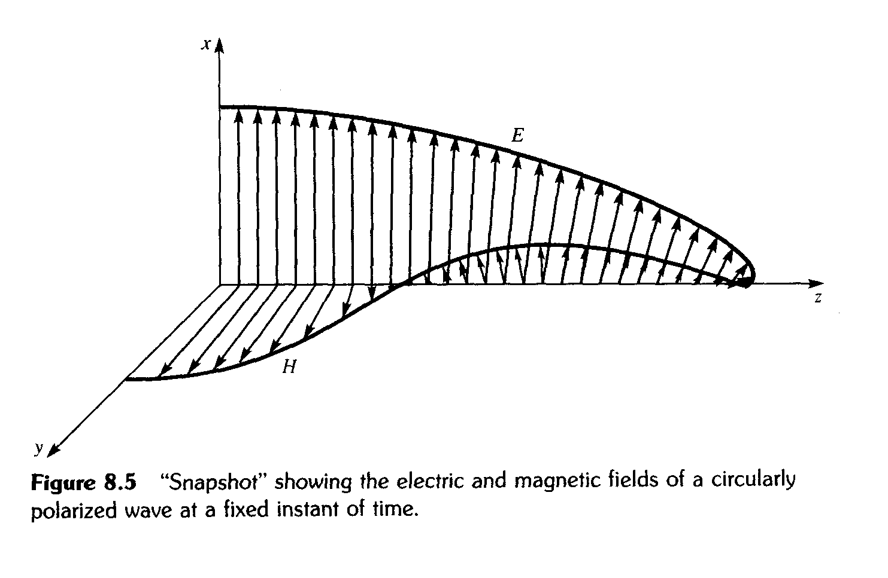
Electromagnetic Waves
Circular polarization
t = const
11

Slide 12
Electromagnetic Waves
Poynting’s Theorem
Poynting’s theorem is an identity based on Maxwell’s equations, which can often be used as an energy-balance equation.
Faraday’s Law
Ampere’s Law
Vector
identity

Slide 13
Electromagnetic Waves
If do not change with time,
Magnetic energy density
Electric energy density
Ohmic losses

Slide 14
Electromagnetic Waves
Integrating over the volume of concern and using the
divergence theorem to convert the volume integral of
to the closed surface integral of we have equation referred to as Poynting’s theorem:
Rate of decrease in energy stored in electric (W_{e}) and magnetic (W_{m}) fields
Ohmic power dissipated as heat
Total (net) power leaving the volume
P_{out} - P_{in}
Poynting vector (represents the power flow per unit area)

Slide 15
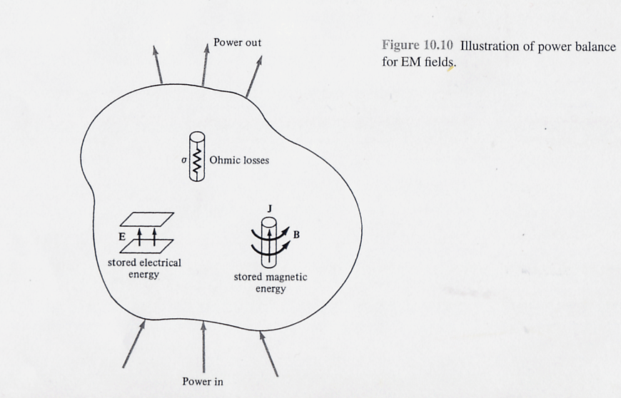
Electromagnetic Waves
Net power (P_{in} - P_{out}) entering the volume
P_{in} - P_{out} =
Power out
Rate of increase in stored W_{e}
Rate of increase in stored W_{m}
Ohmic losses
Power in
(J E dv)

Slide 16
Plane EM wave in a lossless medium
Lossy transmission lines

Slide 17
Lossy medium
Electromagnetic Waves
The time-average Poynting vector for a lossy medium:
The total time-average power crossing a given surface is obtained by integrating over that surface.
17

Slide 18
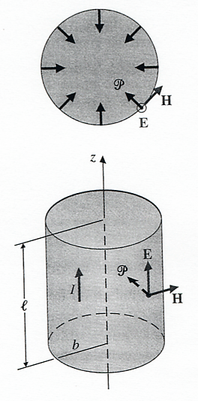
Electromagnetic Waves
Example. Using Poynting’s theorem to find the power dissipated in the wire (of length l and radius b) carrying direct current I.

Slide 19
Time Table, updated on 12/07/20
Course Section | Number of Lectures | HA Given | HW Due | Chapter(s) in Text (Ulaby)
Introduction | 1 | - | - | 1
Transmission Lines (TEM field waves can be represented by V and I (scalars) waves) | 7 | 09/21 | 09/23 | 2
2. Review of Vector Analysis | 5 | 10/05 | 10/07 | 3
3. Electrostatics | 7 | 10/19 | 10/21 | 4
4. Magnetostatics | 5 | 11/02 | 11/04 | 5
5. Time-Varying Fields | 8 | 11/20 | 11/23 | 6, 5.7, 7.5
6. Electromagnetic Waves (TEM) | 6 | 12/07 | 12/09 | 7, 8
Review | 1 | - | - | 1-8
Final Exam (via Honorlock) Group 18C | - | - | 12/18 (F) (12:30-2:30 p.m.) | 1-8

Slide 20
Transmission Lines
Magnetic field
Electric field
Electric and magnetic fields around a two-wire transmission line
(Transverse ElectroMagnetic (TEM) field structure)

Slide 21
6. ELECTROMAGNETIC WAVES - 6 lectures
Free space wave equation
Characteristics of plane waves
Polarization
Poynting's theorem
Reflection at normal incidence

Slide 22
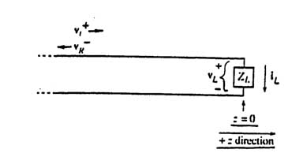
Transmission Lines
Reflection and Transmission
At z = 0,
Z₀
$$\frac{{\underline{v}}_{r}^{−}(z=0)}{{\underline{v}}_{i}^{+}(z=0)}=ρ_{o}$$
Assuming that the incident wave
is known and solving for
, we obtain
$$\frac{{\underline{v}}_{r}^{−}(z=0)}{{\underline{v}}_{i}^{+}(z=0)}=\frac{Z_{L}−Z_{o}}{Z_{L}+Z_{o}}=ρ_{o}$$
Load’s Reflection
Coefficient

Slide 23
Transmission Lines
Reflection and Transmission (continued)
and
If
(short circuit),
Standing wave with the nulls at

Slide 24
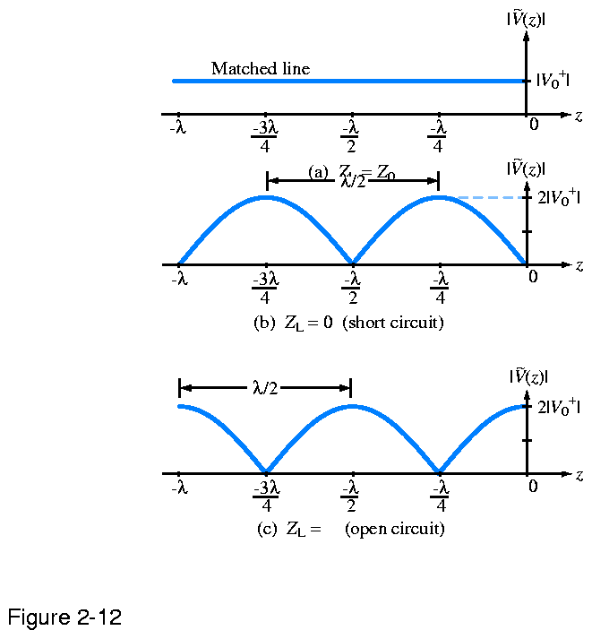
Magnitude of the total voltage phasor
Z_{L} = Z₀
Voltage is the same at any z
$ρ_{o}$= 0
Voltage vanishes at z=0
$ρ_{o}$= -1
Voltage doubles at z=0
$ρ_{o}$= 1
∞
Transmission Lines

Slide 25
Electromagnetic Waves
Reflection and Transmission at Normal Incidence
When a plane wave from one medium meets a different
medium, it is partly reflected and partly transmitted.
If the boundary between the two media is planar and
perpendicular to the wave’s direction of propagation, the
wave is said to be normally incident on the boundary.
Let us consider a wave linearly polarized in the x direction
and propagating in the +z direction, that strikes a perfectly
conducting wall at normal incidence. The wall is located at
z=0.
incident wave
reflected wave

Slide 26
Electromagnetic Waves
At the interface z=0, the boundary conditions require that
the tangential component of E must vanish (since for
z>0)
(This result is similar to the expression for the voltage on a
short-circuited transmission line)
This impedance is analogous to the input impedance
Z(z)=V(z)/I(z) on a transmission line. For a single
x-polarized wave moving in the +z direction ,
intrinsic impedance of the medium.
The wave impedance for two waves moving toward each other is

Slide 27
Electromagnetic Waves
reflection coefficient
transmission coefficient
The incident wave is totally reflected with a phase reversal,
and no power is transmitted across a perfectly conducting
boundary. The conducting boundary acts as a short circuit.
standing wave ratio

Slide 28
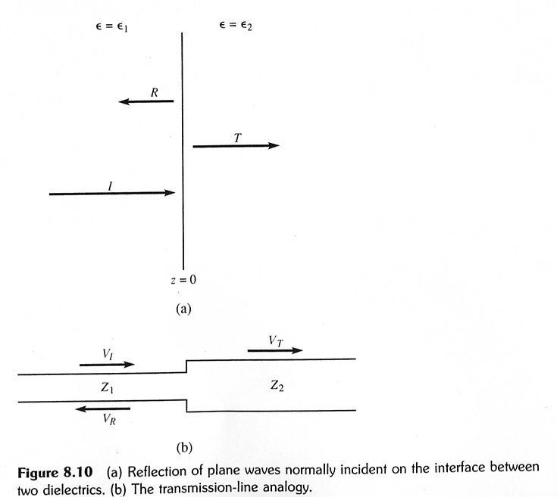
Electromagnetic Waves
Let us next consider the case of a plane wave normally
incident on a dielectric discontinuity

Slide 29
Electromagnetic Waves
At z=0
reflection coefficient
transmission coefficient

Slide 30
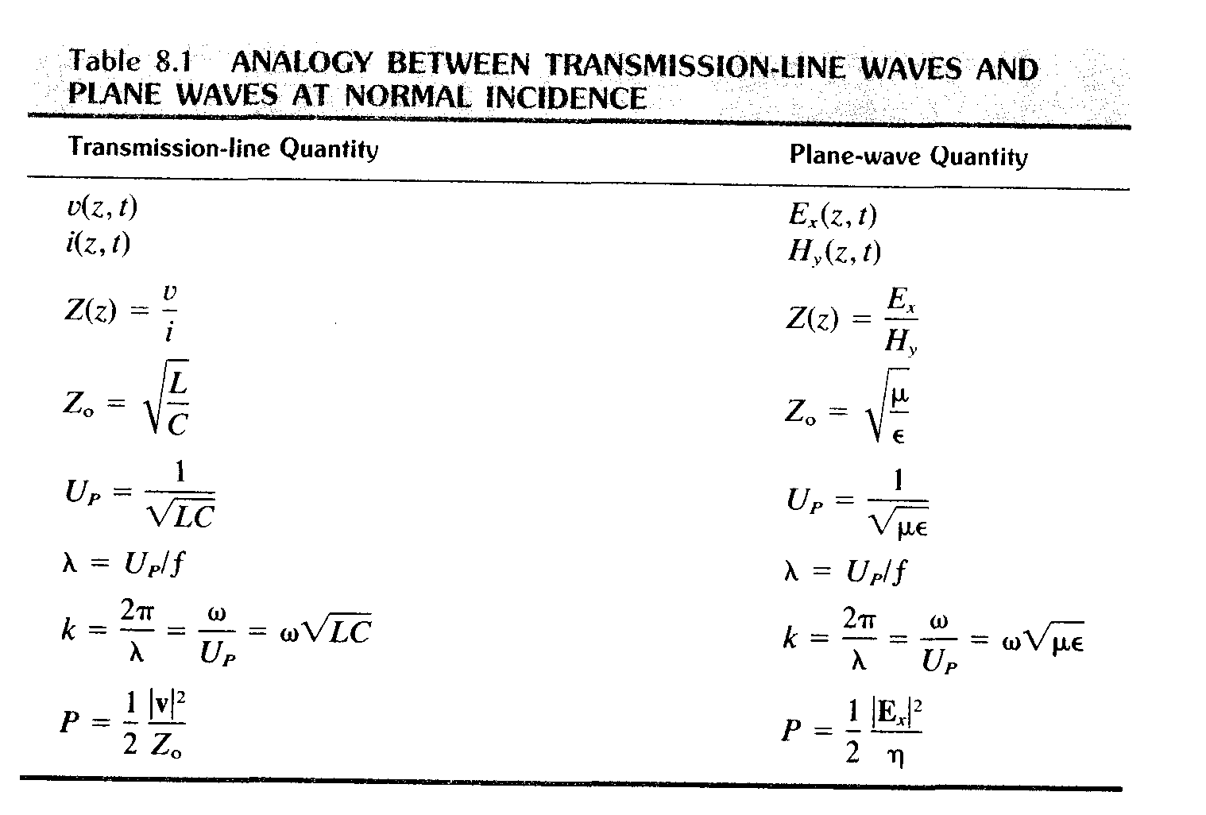
Electromagnetic Waves
No losses!
Input impedance
Wave impedance
Characteristic impedance
Intrinsic impedance of the medium
Time-averaged power density
Time-averaged power density
30

